Slide 1
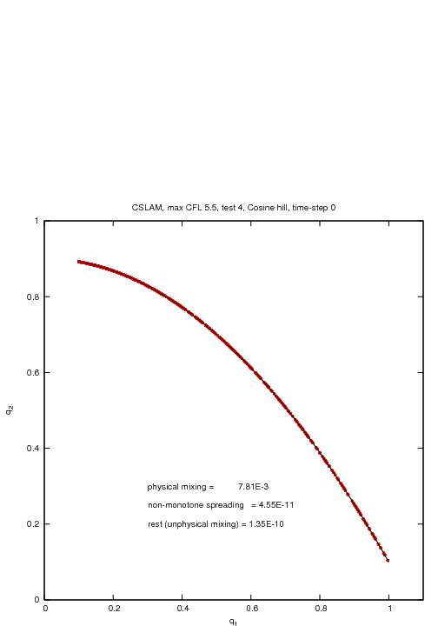
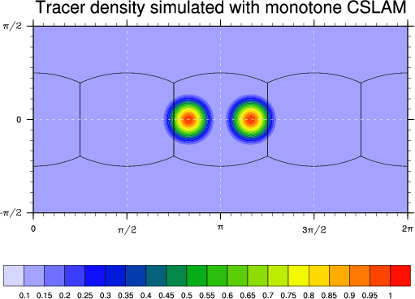
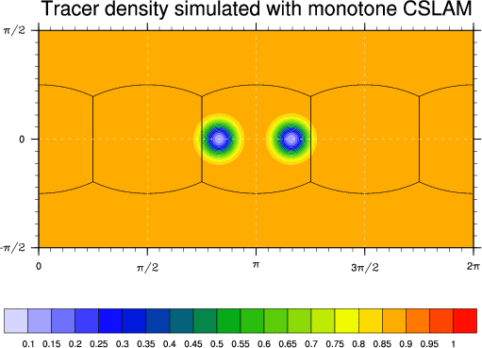
Preserving pre-existing functional relation between tracers under challenging flow conditions
First-order CSLAM: only `real mixing’
Nair and Lauritzen (2010) flow field

Slide 2
Preserving pre-existing functional relation between tracers under challenging flow conditions
Note: 1. Max value decrease, 2. Unmixing even if scheme is shape-preserving, 3. No expanding range unmixing

Slide 3
Preserving pre-existing functional relation between tracers under challenging flow conditions
Note: 1. Max value decrease, 2. Unmixing even if scheme is shape-preserving, 3. No expanding range unmixing

Slide 4
Preserving pre-existing functional relation between tracers under challenging flow conditions
Note: 1. Max value decrease, 2. Unmixing even if scheme is shape-preserving, 3. No expanding range unmixing

Slide 5
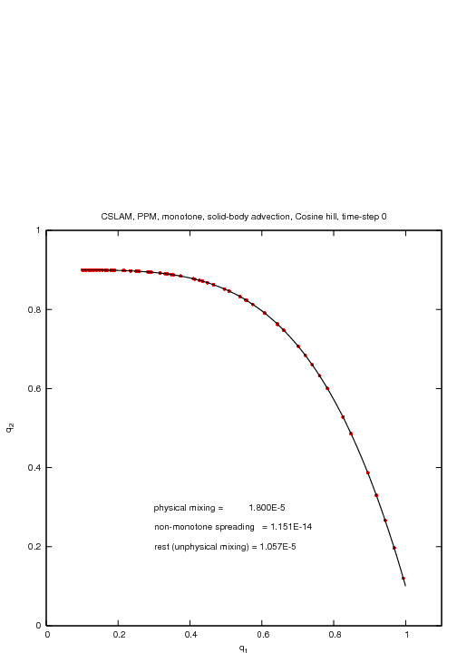
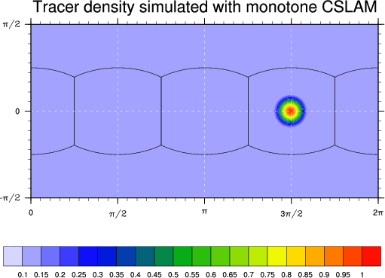
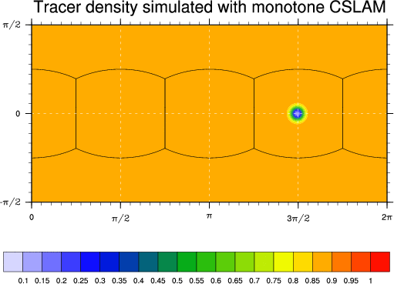
Strongly deformational flow is key!
You want to find out how schemes behave when tracer features collapse to the grid scale
Perhaps the most widely used global idealized tracer transport test case (solid-body advection) is relatively useless for this purpose …
√∫

