Slide 1




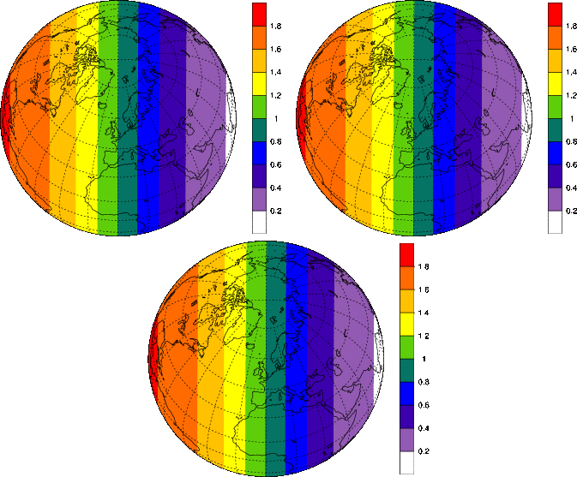
Tracer advection in CAM: new scheme and evaluation
Peter Hjort Lauritzen§, J.-F. Lamarque§, M.J. Prather#, Mark Taylor*,
A. Conley§, S. Goldhaber§, C. Erath§
AMWG/CCWG winter meeting, February 11-12, 2013
§ NCAR *Sandia National Laboratories #University of California, Irvine

Slide 2
What’s going on?
Finite-volume transport in CAM-SE
Specified dynamics option in CAM-SE
(PI: J.-F. Lamarque)
Idealized testing to assess accuracy:
- 2D: prescribed winds, passive transport (large community involvement)
Prescribed 2D passive linear advection option in CAM-SE/FV
(PI: J.-F. Lamarque)
- 3D: Transport and mixing of chemical air masses in idealized baroclinic life cycles
(L. Polvani); Evaluating CAM-SE and CAM-FV (PI: J.-F. Lamarque)
- Idealized non-linear chemistry test case

Slide 3
What’s going on?
Finite-volume transport in CAM-SE
Specified dynamics option in CAM-SE
(PI: J.-F. Lamarque)
Idealized testing to assess accuracy:
- 2D: prescribed winds, passive transport (large community involvement)
Prescribed 2D passive linear advection option in CAM-SE/FV
(PI: J.-F. Lamarque)
- 3D: Transport and mixing of chemical air masses in idealized baroclinic life cycles
(L. Polvani); Evaluating CAM-SE and CAM-FV (PI: J.-F. Lamarque)
- Idealized non-linear chemistry test case

Slide 4
Conservative Semi-LAgrangian Multi-tracer transport scheme
(CSLAM; Lauritzen et al., 2010)
Passive and inert tracer transport with CSLAM is now working in HOMME* (Erath et al., 2012) using spectral element winds.
* HOMME is “providing” the spectral element dynamical core to CAM-SE

Slide 5
Conservative Semi-LAgrangian Multi-tracer transport scheme
(CSLAM; Lauritzen et al., 2010)
Passive and inert tracer transport with CSLAM is now working in HOMME (Erath et al., 2012) using spectral element winds.
- demonstrated multi-tracer efficiency (Erath talk yesterday)

Slide 6
Conservative Semi-LAgrangian Multi-tracer transport scheme
(CSLAM; Lauritzen et al., 2010)
Passive and inert tracer transport with CSLAM is now working in HOMME (Erath et al., 2012) using spectral element winds.
- demonstrated multi-tracer efficiency (Erath talk yesterday)
High resolution ill-conditioning of analytical line-integrals
-> change all line-integrals to Gaussian quadrature and locally
enforce mass-consistency (Erath et al., 2013, revising)
- change does not affect locality and accuracy, and scalability

Slide 7
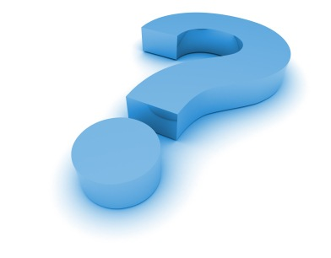
Conservative Semi-LAgrangian Multi-tracer transport scheme
(CSLAM; Lauritzen et al., 2010)
Passive and inert tracer transport with CSLAM is now working in HOMME (Erath et al., 2012) using spectral element winds.
- demonstrated multi-tracer efficiency (Erath talk yesterday)
High resolution ill-conditioning of analytical line-integrals
-> change all line-integrals to Gaussian quadrature and locally
enforce mass-consistency (Erath et al., 2013, revising)
- change does not affect locality and accuracy, and scalability
So why are we not showing AMIP simulations with CSLAM?

Slide 8
CSLAM coupling with spectral element dynamics (1/2)
(work in progress)
Equiangular finite-volume physics grid in CAM-SE
When I/O and physics on finite-volume grid is working in CAM-SE,
CSLAM transport (without SE-CSLAM air density coupling) should be
available.
without SE-CSLAM air density coupling? CSLAM evolves its own density and CAM-SE evolves it own density
(this inconsistency appears when using different numerical methods and/or different time-steps for air and tracers)

Slide 9
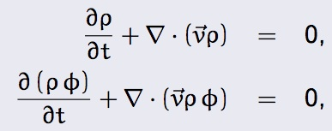
CSLAM coupling with spectral element dynamics (2/2)
(and specified dynamics option in CAM-SE)
Continuity equation for air and tracer (rho=density, phi=mixing ratio):
If phi=1 then tracer equation should reduce to air density equation
Similarly for specified dynamics: offline data wind-mass balance does not equal the dynamical core wind-mass balance
(M. Prather, P. Cameron-Smith)
A “safe” solution for SE-CSLAM coupling: move to Flux-Form version of CSLAM (FF-CSLAM; Harris et al., 2011) and use well-known and well-tested finite-volume “flux-tricks”
CAM-SE
CSLAM

Slide 10
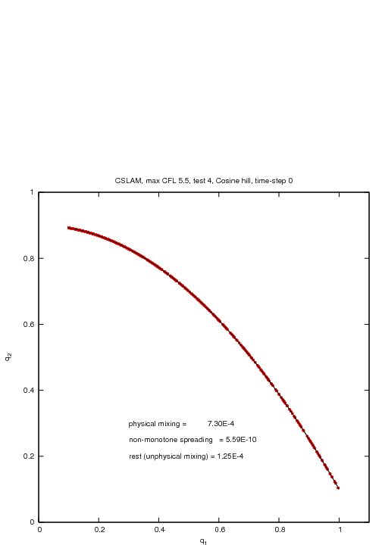
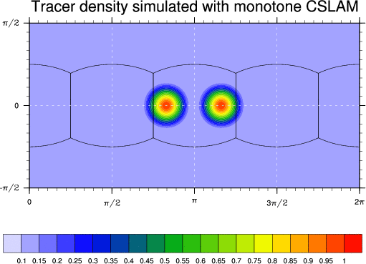
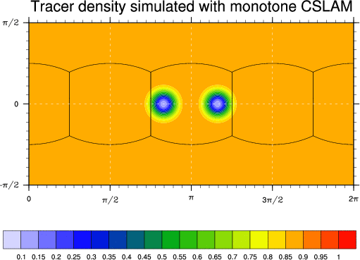
Accuracy of transport
Idealized passive transport test case suite
designed to assess:
- numerical order of convergence
- `minimal’ resolution
- ability to transport ‘rough’ distributions
- ability to preserve pre-existing functional
relations between species,
- ability to preserve filaments
under challenging flow conditions
(Lauritzen, Skamarock, Prather and Taylor, 2012)
(Nair and Lauritzen, 2010)

Slide 11
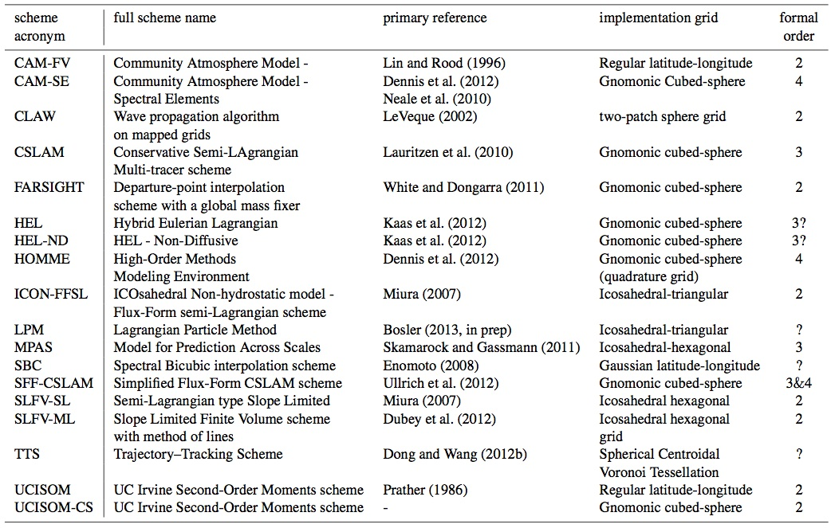
Accuracy of transport: workshop

Slide 12
Accuracy of transport: workshop

Slide 13
Accuracy of transport: workshop
HOMME and CAM-SE codes are identical, however, different hyper-viscosity coefficients and polynomial order:
CAM-SE is running with default climate setup!

Slide 14
Lauritzen et al., 2013 (in prep)

Slide 15
Lauritzen et al., 2013 (in prep)

Slide 16
Lauritzen et al., 2013 (in prep)

Slide 17
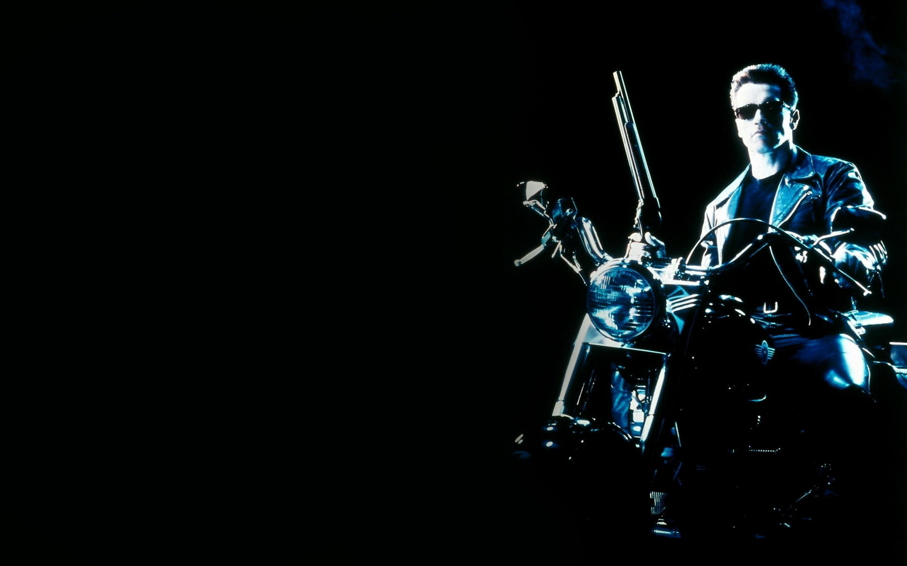
`
The
terminator
test

Slide 18
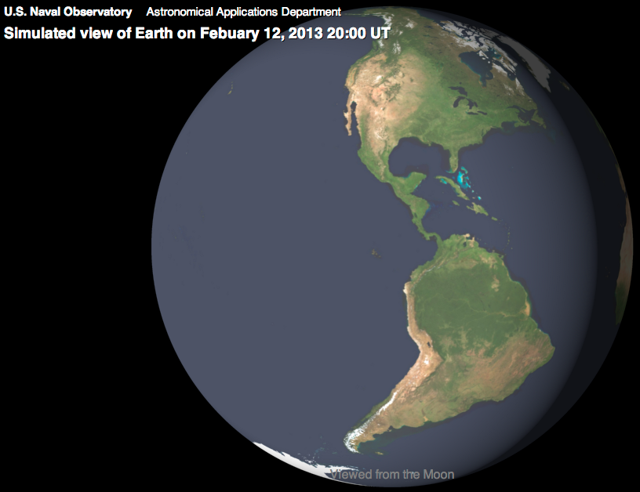
`
The
terminator
test
Very preliminary
Design and testing

Slide 19
Example: Br
Goal:
Formulate an idealized test case with non-linear chemistry (relevant for photolysis
driven chemistry).
Use 1. for investigating high-order transport/chemistry coupling

Slide 20

Beyond passive idealized transport testing: “Toy” chemistry
Two Chlorine species (Cl and Cl2) that react non-linearly: k1>>k2 - terminator
Total amount of Chlorine (Cly=2*Cl+Cl2) is conserved.
Figure shows k1 (k2 is constant)
Figure illustrating
Flow field

Slide 21
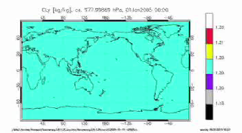
Beyond passive transport idealized testing: “Toy” chemistry
Results for CAM-FV

Slide 22
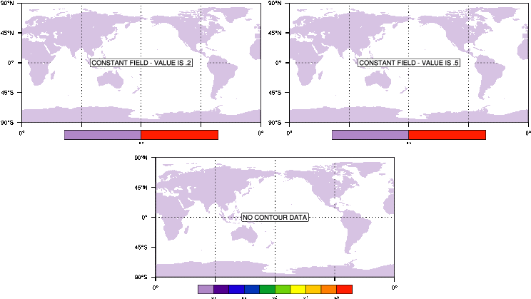
Properties of CSLAM important for chemistry
(preserves linear relations even when using shape-preserving limiter)
Cl
Cl2
Non-linear
“terminator-toy”
chemistry:
Cly=Cl+2*Cl2

