Slide 1





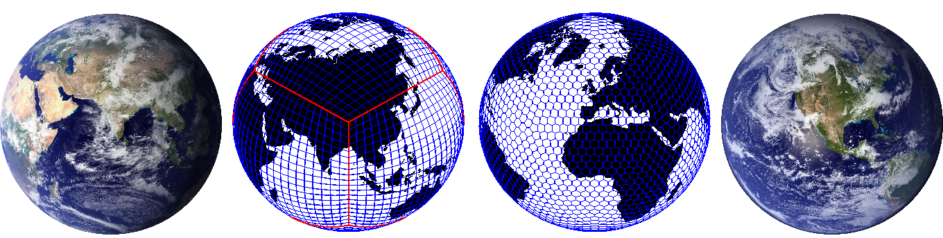
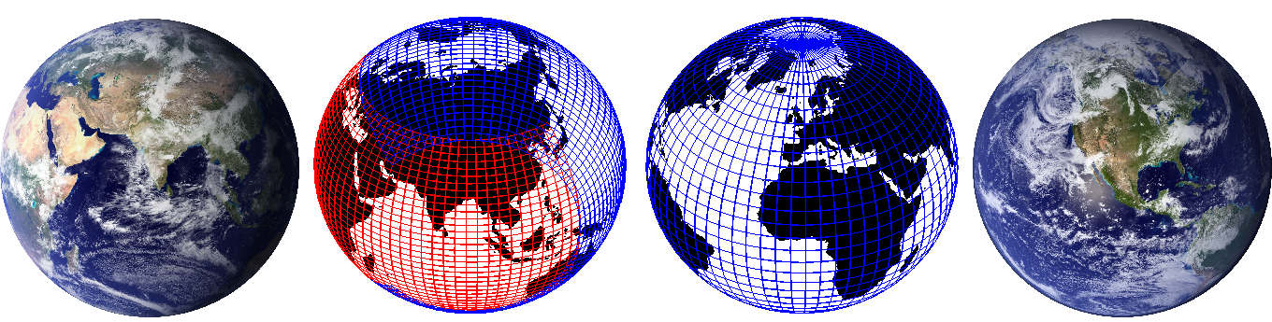
Results from a transport scheme intercomparison and design of a new
non-linear transport-chemistry test
Peter Hjort Lauritzen (NCAR), J.-F. Lamarque (NCAR),
M.J. Prather (U.C. Irvine), W.C. Skamarock (NCAR) and
M.A. Taylor (SNL)
Seminar at Max−Planck−Institut für Meteorologie (MPI-M)
July 23, 2013

Slide 2
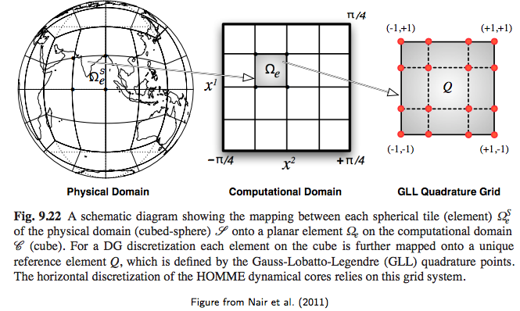
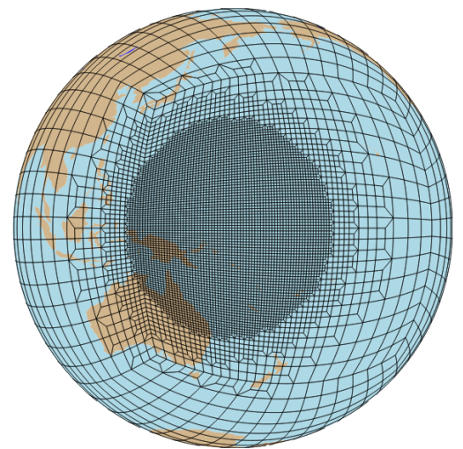
Some things that I will NOT talk about
Release of Spectral-Element (SE) dynamical core in CAM:
SE 1 degree CAM5 “AMIP” configuration are now scientifically supported!
(SE supports mesh-refinement)
SE supports
mesh-refinement

Slide 3
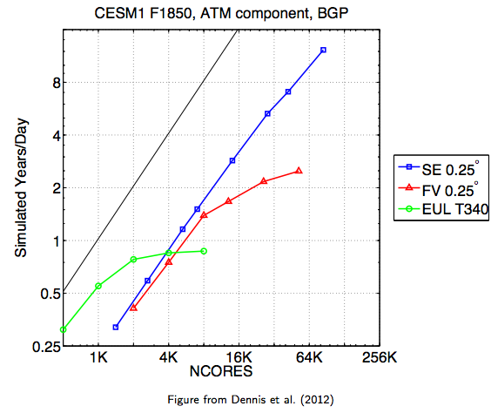
Some things that I will NOT talk about
Release of Spectral-Element (SE) dynamical core in CAM:
SE 1 degree CAM5 “AMIP” configuration are now scientifically supported!
(SE supports mesh-refinement)

Slide 4
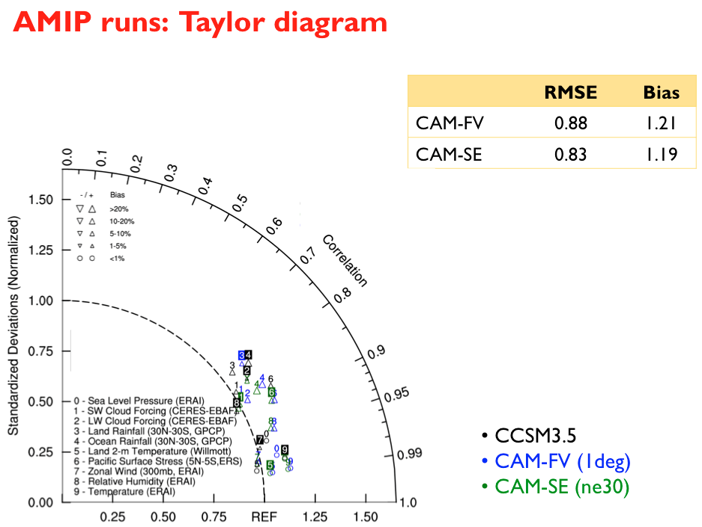
Some things that I will NOT talk about
Release of Spectral-Element (SE) dynamical core in CAM:
SE 1 degree CAM5 “AMIP” configuration are now scientifically supported!

Slide 5
Some things that I will NOT talk about
2. New topography generation software for unstructured grids with
consistent computation of sub-grid-scale variables (for turbulent mountain
stress & orographic gravity wave drag): released with CAM5.3

Slide 6
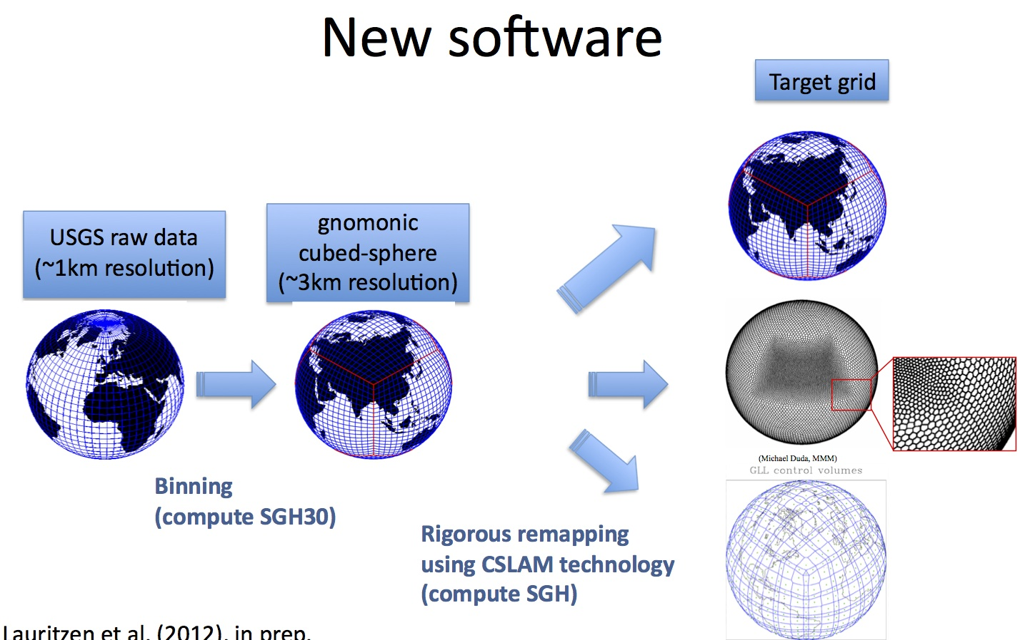
Some things that I will NOT talk about
2. New topography generation software for unstructured grids with
consistent computation of sub-grid-scale variables (for turbulent mountain
stress & orographic gravity wave drag): released with CAM5.3

Slide 7
Some things that I will NOT talk about
3. Gone through exercise of smoothing PHIS for spectral-element dynamical
core (height smoothing is only “trivial” for spectral transform dynamical cores!)

Slide 8
Some things that I will NOT talk about
4. CSLAM (Conservative Semi-Lagrangian Multi-tracer scheme) developments:

Slide 9
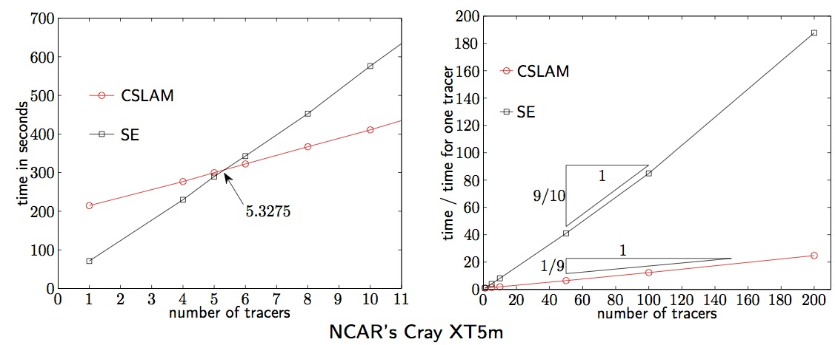
Some things that I will NOT talk about
4. CSLAM (Conservative Semi-Lagrangian Multi-tracer scheme) developments:
a. Implemented in spectral element (SE) dynamical core for inert transport
(Erath et. al. 2012)

Slide 10
Some things that I will NOT talk about
4. CSLAM (Conservative Semi-Lagrangian Multi-tracer scheme) developments:
a. Implemented in spectral element (SE) dynamical core for inert transport
(Erath et. al. 2012)
b. CSLAM-SW: shallow water model with semi-implicit CSLAM time-stepping
(consistent transport)
Wong, May, William C. Skamarock, Peter H. Lauritzen, Roland B. Stull, 2013: A Cell-Integrated Semi-Lagrangian Semi-Implicit
Shallow-Water Model (CSLAM-SW) with Conservative and Consistent Transport. Mon. Wea. Rev., 141, 2545–2560.
c. CSLAM-NH: non-hydrostatic fully compressible semi-implicit solver
in x-z place with consistent tracer transport
PhD thesis : M. Wong (University of British Columbia, Vancouver; UBC)
PhD committee : Skamarock (NCAR), Lauritzen (NCAR), Stull (UBC)

Slide 11
Outline
2. “Toy chemistry” Beyond linear transport scheme tests …
1. Results from a collection of state-of-the-art transport scheme
(including ICON) exercising new standard test case suite:

Slide 12
Why focus on transport ?
Almost all major modeling centers are developing new scalable dynamical
cores – a transport operator is a basic building block!
Accurate tracer transport is becoming increasingly important:
- Microphysics: mass & number concentrations for water vapor, cloud ice & liquid (rain, snow, ..)
- Aerosols: sulfate, black carbon, etc. accounted for in three modes
- Chemical species
– large gradients, features “collapse” to the grid scale, …
Consistent air density and tracer mass transport!
- particularly important for chemistry
Tracer transport can account for most of the computational cost of
“resolved” scale dynamics computations
- e.g., 26+ tracers to prognose in CAM5; 126+ in chemistry version
Multi-tracer efficiency is becoming increasingly important
Compute architectures are changing: “Multi-everything”

Slide 13
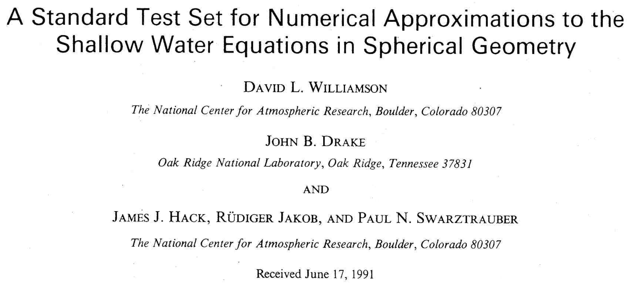
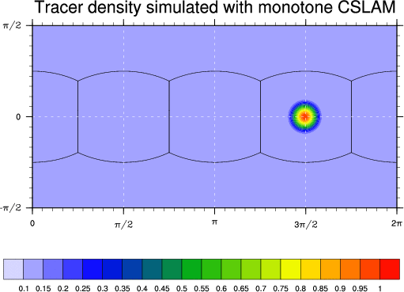
Most widely used test case in the literature (global models) ?
Test 1: Solid-body advection

Slide 14
Most widely used test case in the literature (global models) ?
1. No deformation only translation:
-> Flow does not force tracer features to collapse to the
grid scale (as they do in real applications)
2. No forcing/physics
Experienced modelers know that schemes that may perform well
in idealized settings may “fail” when adding moist physics …!
Test 1: Solid-body advection

Slide 15
Part 2

Slide 16
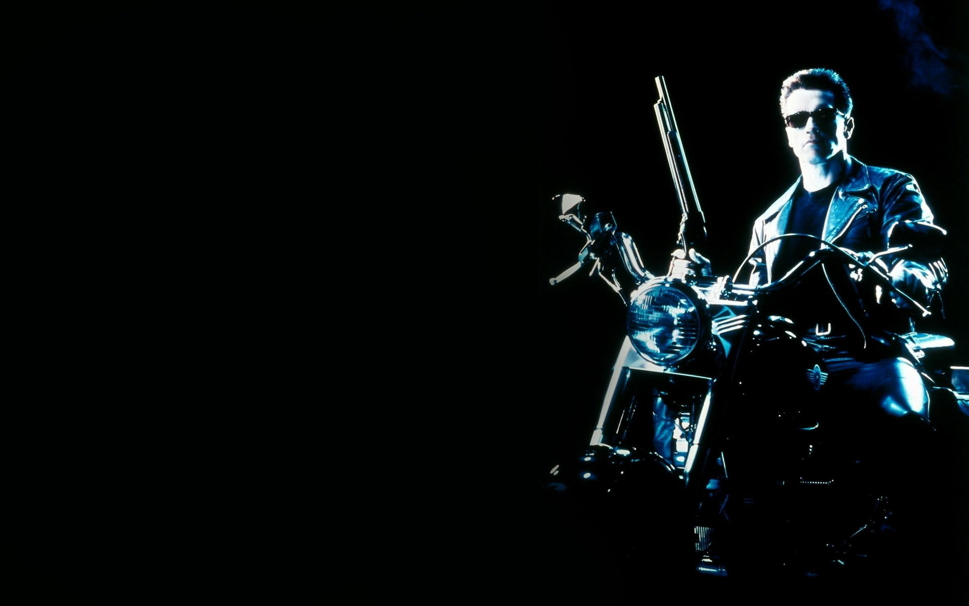
`
The
terminator
test

Slide 17
Go a step beyond inert transport testing, that is, add non-linear forcing to idealized flow problem!
At the same time keep things simple enough to be able determine/understand cause and effect
An option: simplified chemical reactions
(right-hand side is products of mixing ratios)
√∫

Slide 18
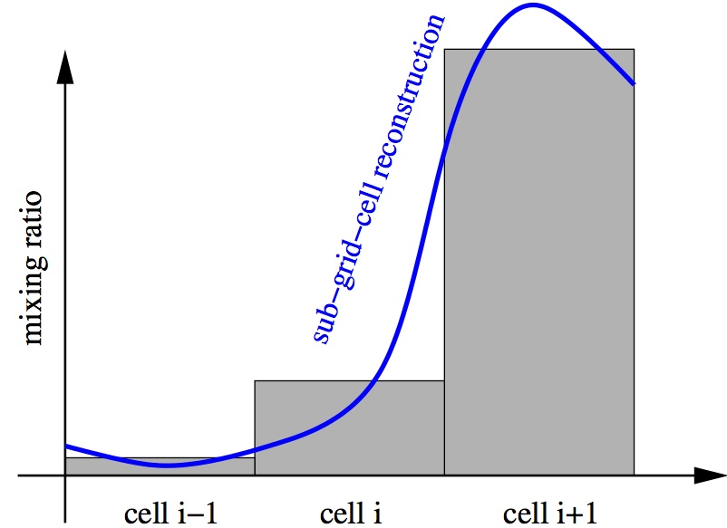
Longer term motivation
Create a simple framework to investigate possible benefits/issues with
“higher-order” spatial coupling between dynamics and physics:
- running physics on a different grid than dynamics
- pass sub-grid-scale variance of tracers (from dynamics) to physics
√∫

Slide 19
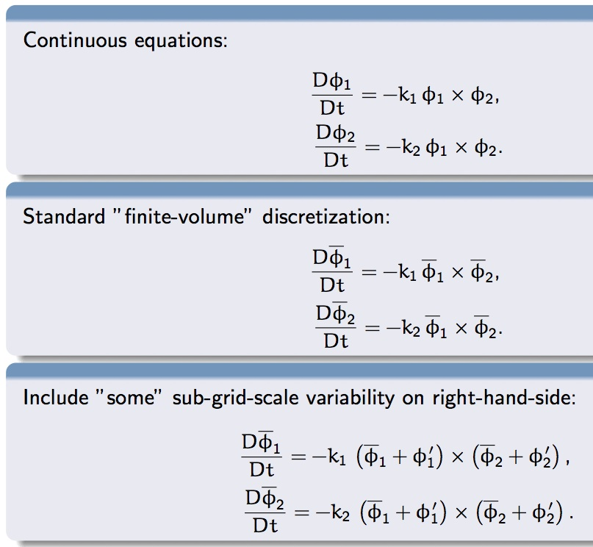
√∫

Slide 20
“Inspiration” 1:
Photolysis driven chemistry

Slide 21
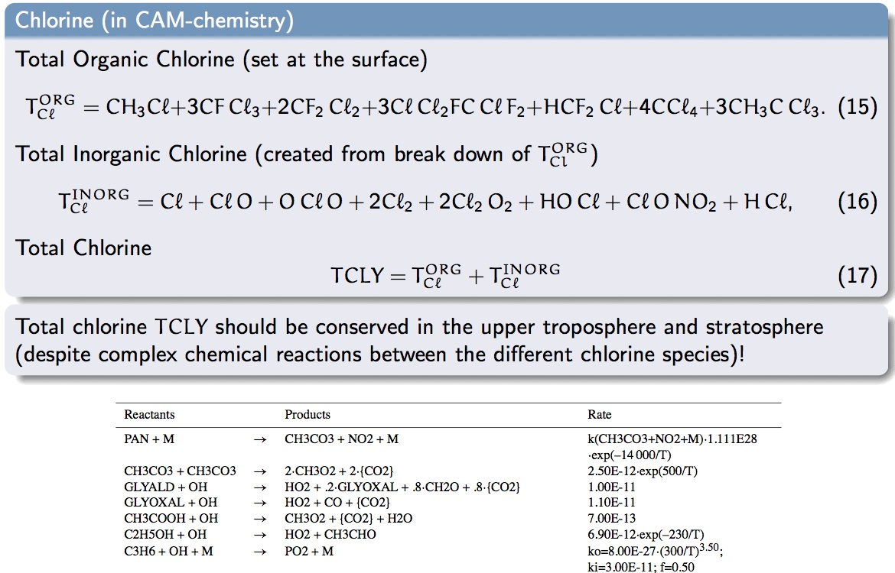
“Inspiration” 2: “Preserving sums”

Slide 22
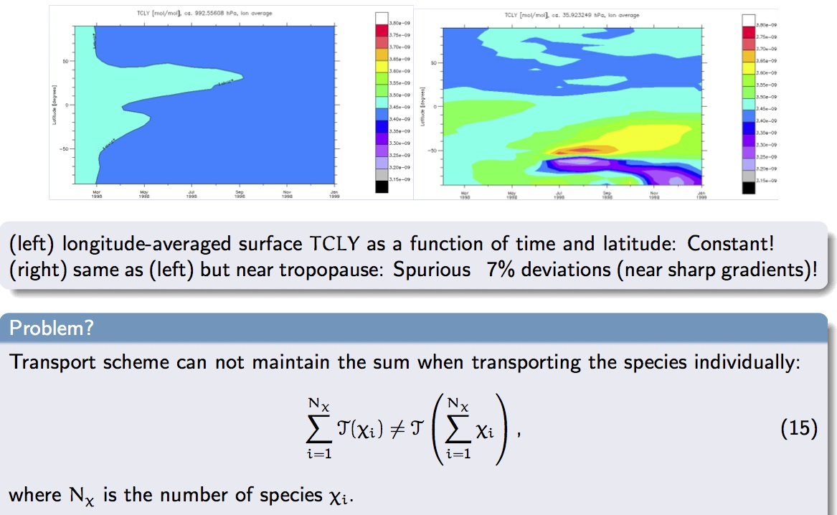
“Inspiration” 2: “Preserving sums”

Slide 23
“Inspiration” 2: “Preserving sums”
For a test to assess how well sums are preserved for inert linear transport (no chemistry) see Lauritzen and Thuburn (2011, QJRMS)

Slide 24

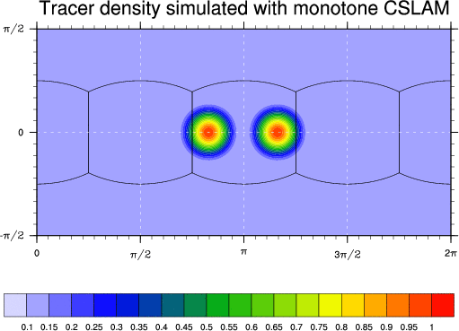
Beyond passive idealized transport testing: “Toy” chemistry
Two Chlorine species (Cl and Cl2) that react non-linearly: k1>>k2 - terminator
Total amount of Chlorine (Cly=2*Cl+Cl2) is conserved.
Figure shows k₁ (k₂ is constant)
Figure illustrating
Flow field

Slide 25
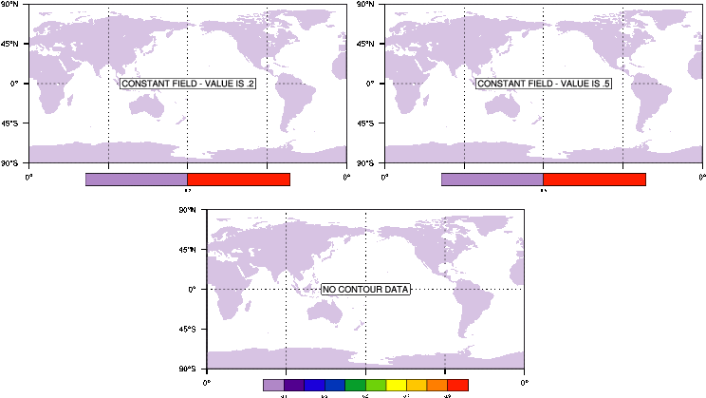
Cl
Cl₂
Non-linear
“terminator-toy”
chemistry:
Cl_{y}=Cl+2*Cl₂

Slide 26
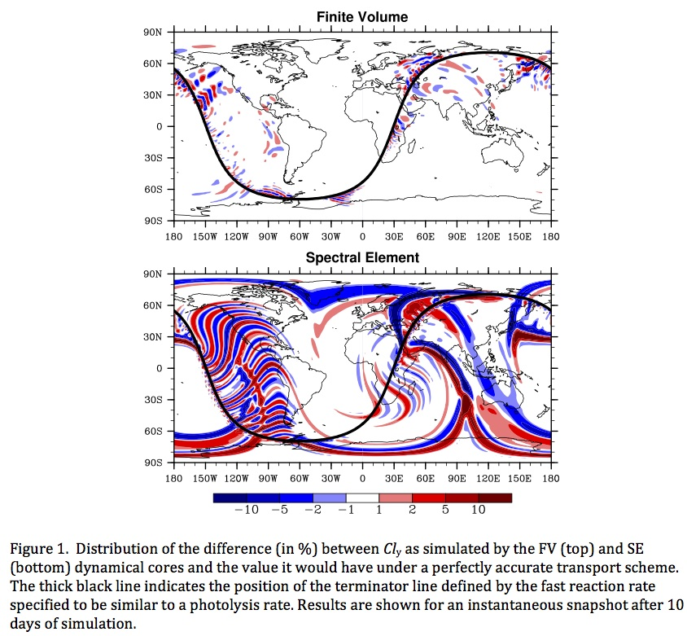
√∫

Slide 27
These are the basic ideas …
Exact test case specification is still work-in-progress …

Slide 28
Part 1

Slide 29
Design objectives
Facilitate scheme intercomparison (model development)
(specific guidelines on resolution, test case configuration)
Assess important aspects of accuracy in geophysical fluid dynamics
(that we believe current idealized testing does not!) using a “minimal”
test case suite
Keep things simple !!!!
Only 2 analytical wind fields and 4 initial conditions – the rest is diagnostics!
(almost any test case suite could be extended to include more tests that could provide more insights into specific aspects of accuracy particularly useful for some classes of schemes and applications)
Assume that scheme developers have already tested their scheme with simpler test cases (solid-body rotation, etc.) and we do not ask modelers to report on them

Slide 30
NCAR Workshop (March, 2011)
community asked to bring solutions to new test suite
Passive & inert idealized 2D transport test cases designed to assess:
1. Numerical order of convergence (C∞ initial conditions) – Δx in [0.3º ,3º]
2. “Minimal” resolution (C¹ initial conditions)
3. Ability of transport scheme to preserve filaments
4. Ability of transport scheme to transport “rough” distributions
5. Ability of the transport scheme to preserve pre-existing functional
relations between species (e.g., N₂O-NO_{y}, family of species, …)
under challenging flow conditions
u(λ, θ, t) = κ sin2(λ’) sin(2θ) cos(πt/T ) + 2π cos(θ)/T
v(λ, θ, t) = κ sin(2λ’) cos(θ) cos(πt/T ),
(Nair and Lauritzen, 2010, JCP).
6. Transport under divergent flow conditions (forces modelers to consider coupling between air and tracer mass; at least for finite-volume based schemes)

Slide 31

http://www.geosci-model-dev.net/5/887/2012/gmd-5-887-2012.pdf

Slide 32
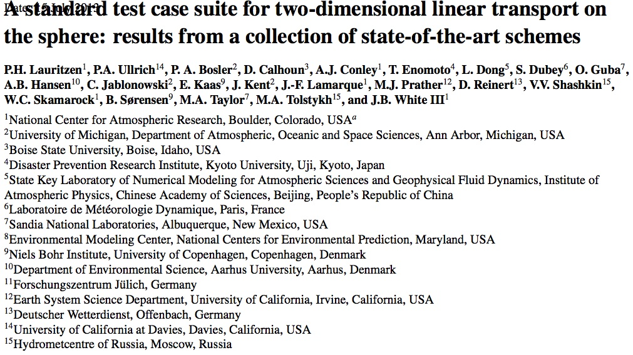
Comparison/”database” manuscript:
Lauritzen et al., 2013, “almost done”)

Slide 33
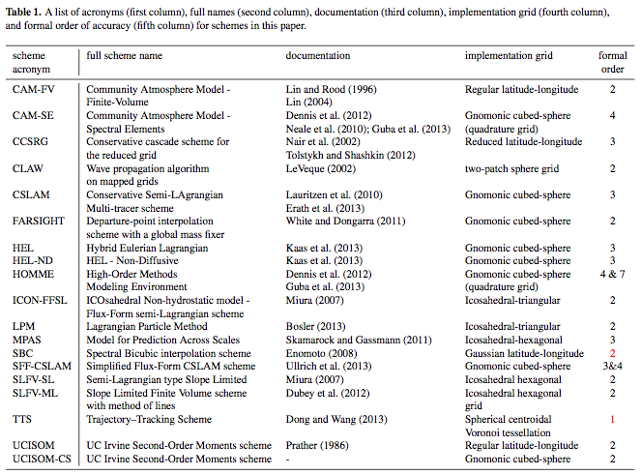
Comparison/”database” manuscript:
Lauritzen et al., 2013, “almost done”)

Slide 34
CSLAM = Conservative Semi-LAgrangian Multi-tracer scheme
Lauritzen et al. (2010,JCP), Harris et al. (2011), Lauritzen et al. (2011,JCP)

Slide 35
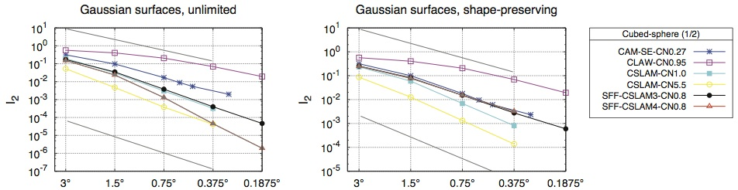
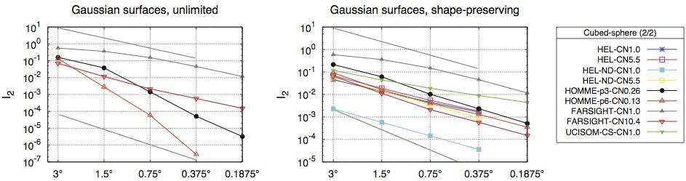
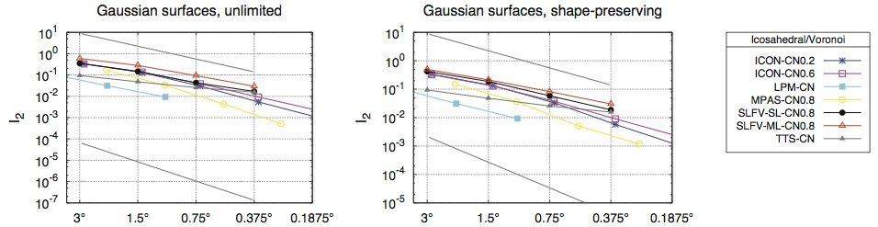
1. Numerical convergence rate in the resolution range approximately 3° to 0.3° (i.e. from paleo to high resolution climate modeling)
Lauritzen et al. (2013, “almost done”),

Slide 36
1. Numerical convergence rate in the resolution range approximately 3° to 0.3° (i.e. from paleo to high resolution climate modeling)
Initial condition and flow (except the poles) is infinitely smooth: Hence schemes should (at high enough resolution) converge at their formal order of accuracy!
Slope: Schemes differ significantly in when asymptotic convergence is achieved
Absolute values: test diagnostic 2
Lauritzen et al. (2013, “almost done”),

Slide 37
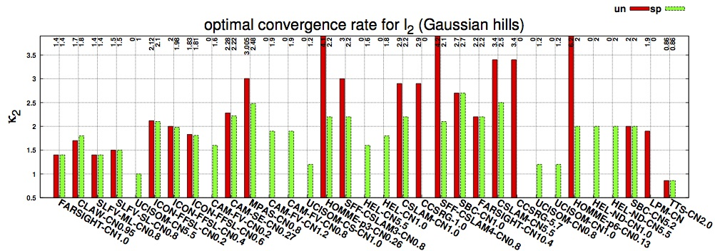
1. Numerical convergence rate in the resolution range approximately 3° to 0.3° (i.e. from paleo to high resolution climate modeling)
un = unlimited scheme sp = shape-preserving version of scheme
In scheme acronym labels: CN = Courant Number
K₂ = Least-squares regression to l2 in range [0.2°,3°]
Note: resolution range was deliberately chosen to challenge schemes
(for a resolution range with finer resolutions features would be well-resolved)
Lauritzen et al. (2013, “almost done”),

Slide 38
1. Numerical convergence rate in the resolution range approximately 3° to 0.3° (i.e. from paleo to high resolution climate modeling)
un = unlimited scheme sp = shape-preserving version of scheme
In scheme acronym labels: CN = Courant Number
Ordering of x-axis will be explained in a moment!
K₂ = Least-squares regression to l2 in range [0.2°,3°]
Note: resolution range was deliberately chosen to challenge schemes
(for a resolution range with finer resolutions features would be well-resolved)
Lauritzen et al. (2013, “almost done”),

Slide 39
1. Numerical convergence rate in the resolution range approximately 3° to 0.3° (i.e. from paleo to high resolution climate modeling)
un = unlimited scheme sp = shape-preserving version of scheme
CN = Courant Number
Not surprisingly shape-preserving filters/limiters reduce order of convergence
Some shape-preserving filters/limiters are more “invasive” than others
For some schemes convergence rates are affected by time-step
K₂ = Least squares regression to l2 in range [0.2°,3°]
Note: resolution range was deliberately chosen to challenge schemes
(for a resolution range with finer resolutions features would be well-resolved)
Lauritzen et al. (2013, “almost done”),

Slide 40
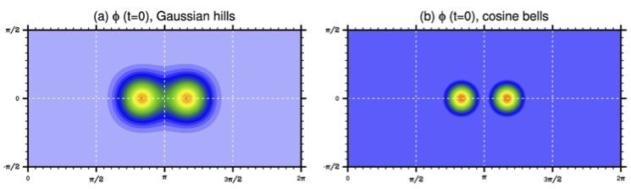
2. “Minimal” resolution
(absolute error)
At what resolution is a certain level of accuracy reached?
Level of accuracy is defined in terms of RMS type error norm
Now initial conditions are C^1 continuous
Lauritzen et al. (2013, “almost done”),

Slide 41
2. “Minimal” resolution
(absolute error)
Somewhat subjective choice: the threshold error norm is based on CSLAM
l2-error norm for which CSLAM starts to converge asymptotically
(filaments are in some sense resolved!)
Lauritzen et al. (2012, GMD)

Slide 42
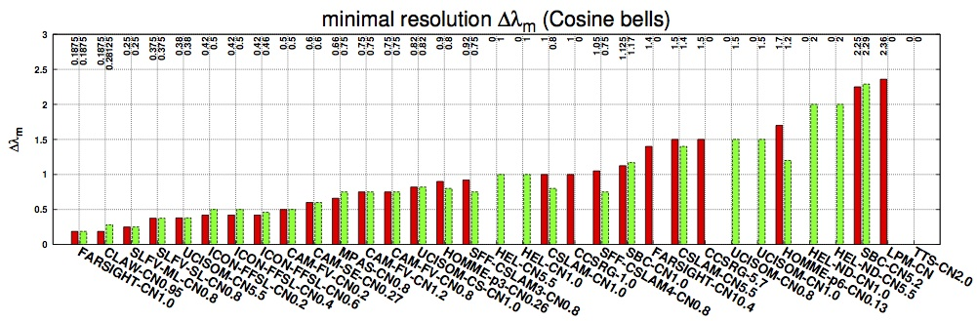
2. “Minimal” resolution
(absolute error)
Minimal resolution varies from 0.2° to 2.3°!
Lauritzen et al. (2013, “almost done”),

Slide 43
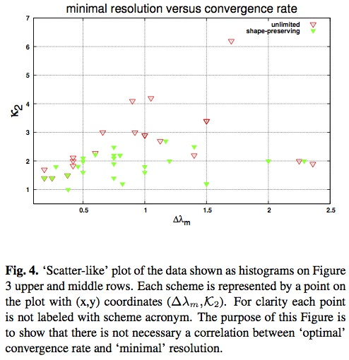
“Minimal” resolution and optimal convergence rates
Lauritzen et al. (2013, “almost done”),

Slide 44
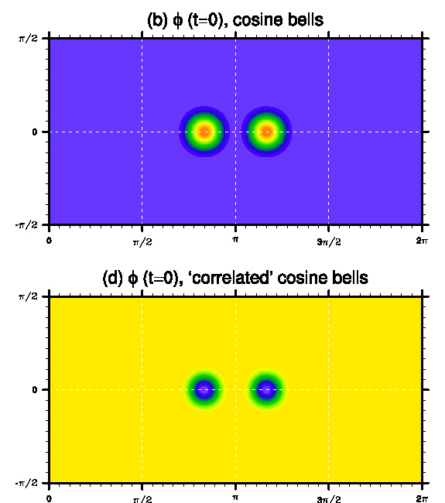
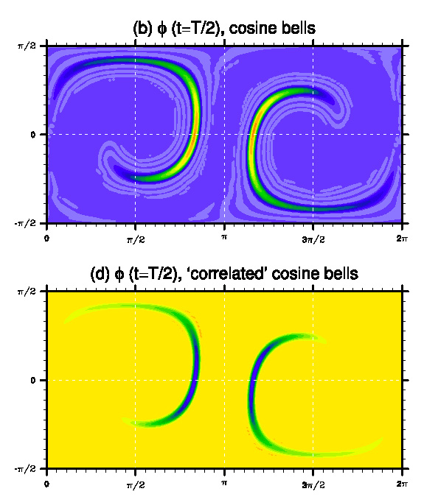
3. Filament diagnostic (Prather)
This diagnostic does not rely on an analytical solution!
Lauritzen et al. (2013, “almost done”),

Slide 45
3. Filament diagnostic
Diffusive schemes will tend to decrease l_{f} for higher values of tau and increase l_{f}
for low values of tau:
Lauritzen et al. (2013, “almost done”),

Slide 46
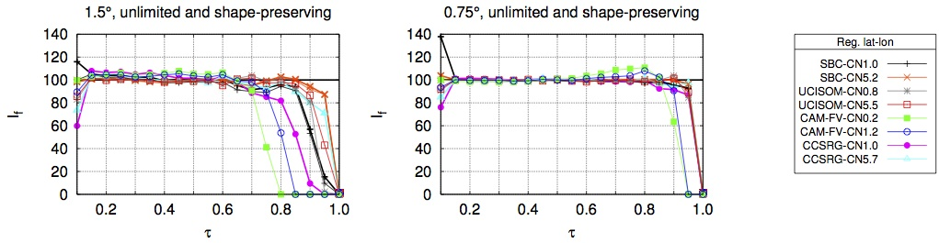
3. Filament diagnostic
Schemes that steepen gradients will have l_{f}>100 for higher tau values:
Lauritzen et al. (2013, “almost done”),

Slide 47
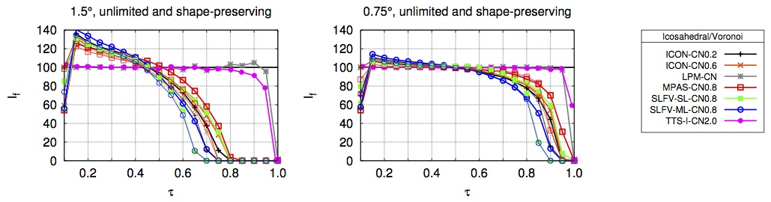
3. Filament diagnostic
How is ICON doing?
l_{f} is a smooth and monotone curve ☺
Lauritzen et al. (2013, “almost done”),

Slide 48
4. “Rough” distribution
(to challenge limiters/filters)
Initial condition
Background value is
non-zero so positivity
preserving filters do not
alleviate undershoots!
Lauritzen et al. (2013, “almost done”),

Slide 49
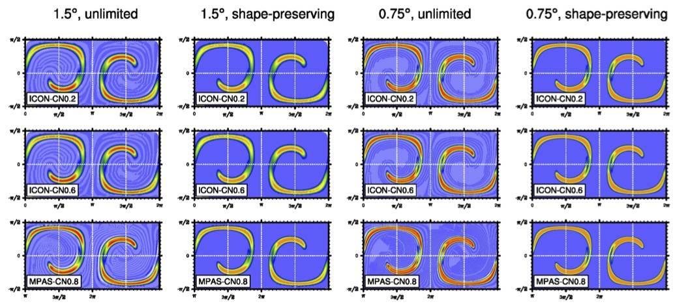
4. “Rough” distribution
(to challenge limiters/filters)
Lauritzen et al. (2013, “almost done”),

Slide 50
5. Preserving correlations
(the design of schemes that preserve linear correlations was discussed by Lin and Rood (1996) and Thuburn and McIntyre (1997))

Slide 51
5. Preserving correlations

Slide 52
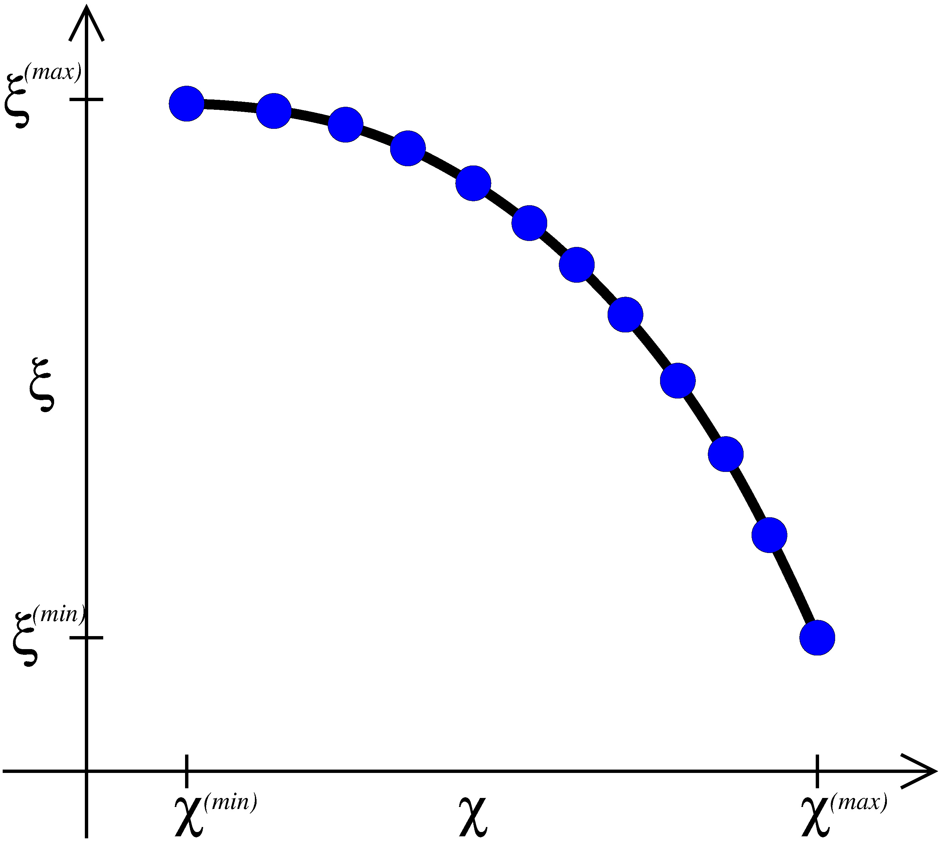
5. Preserving correlations
Initial conditions
tracer 1: cosine bells tracer 2: correlated cosine bells Ψ(χ)=aχ²+b
Lauritzen and Thuburn (2011,QJRMS)

Slide 53
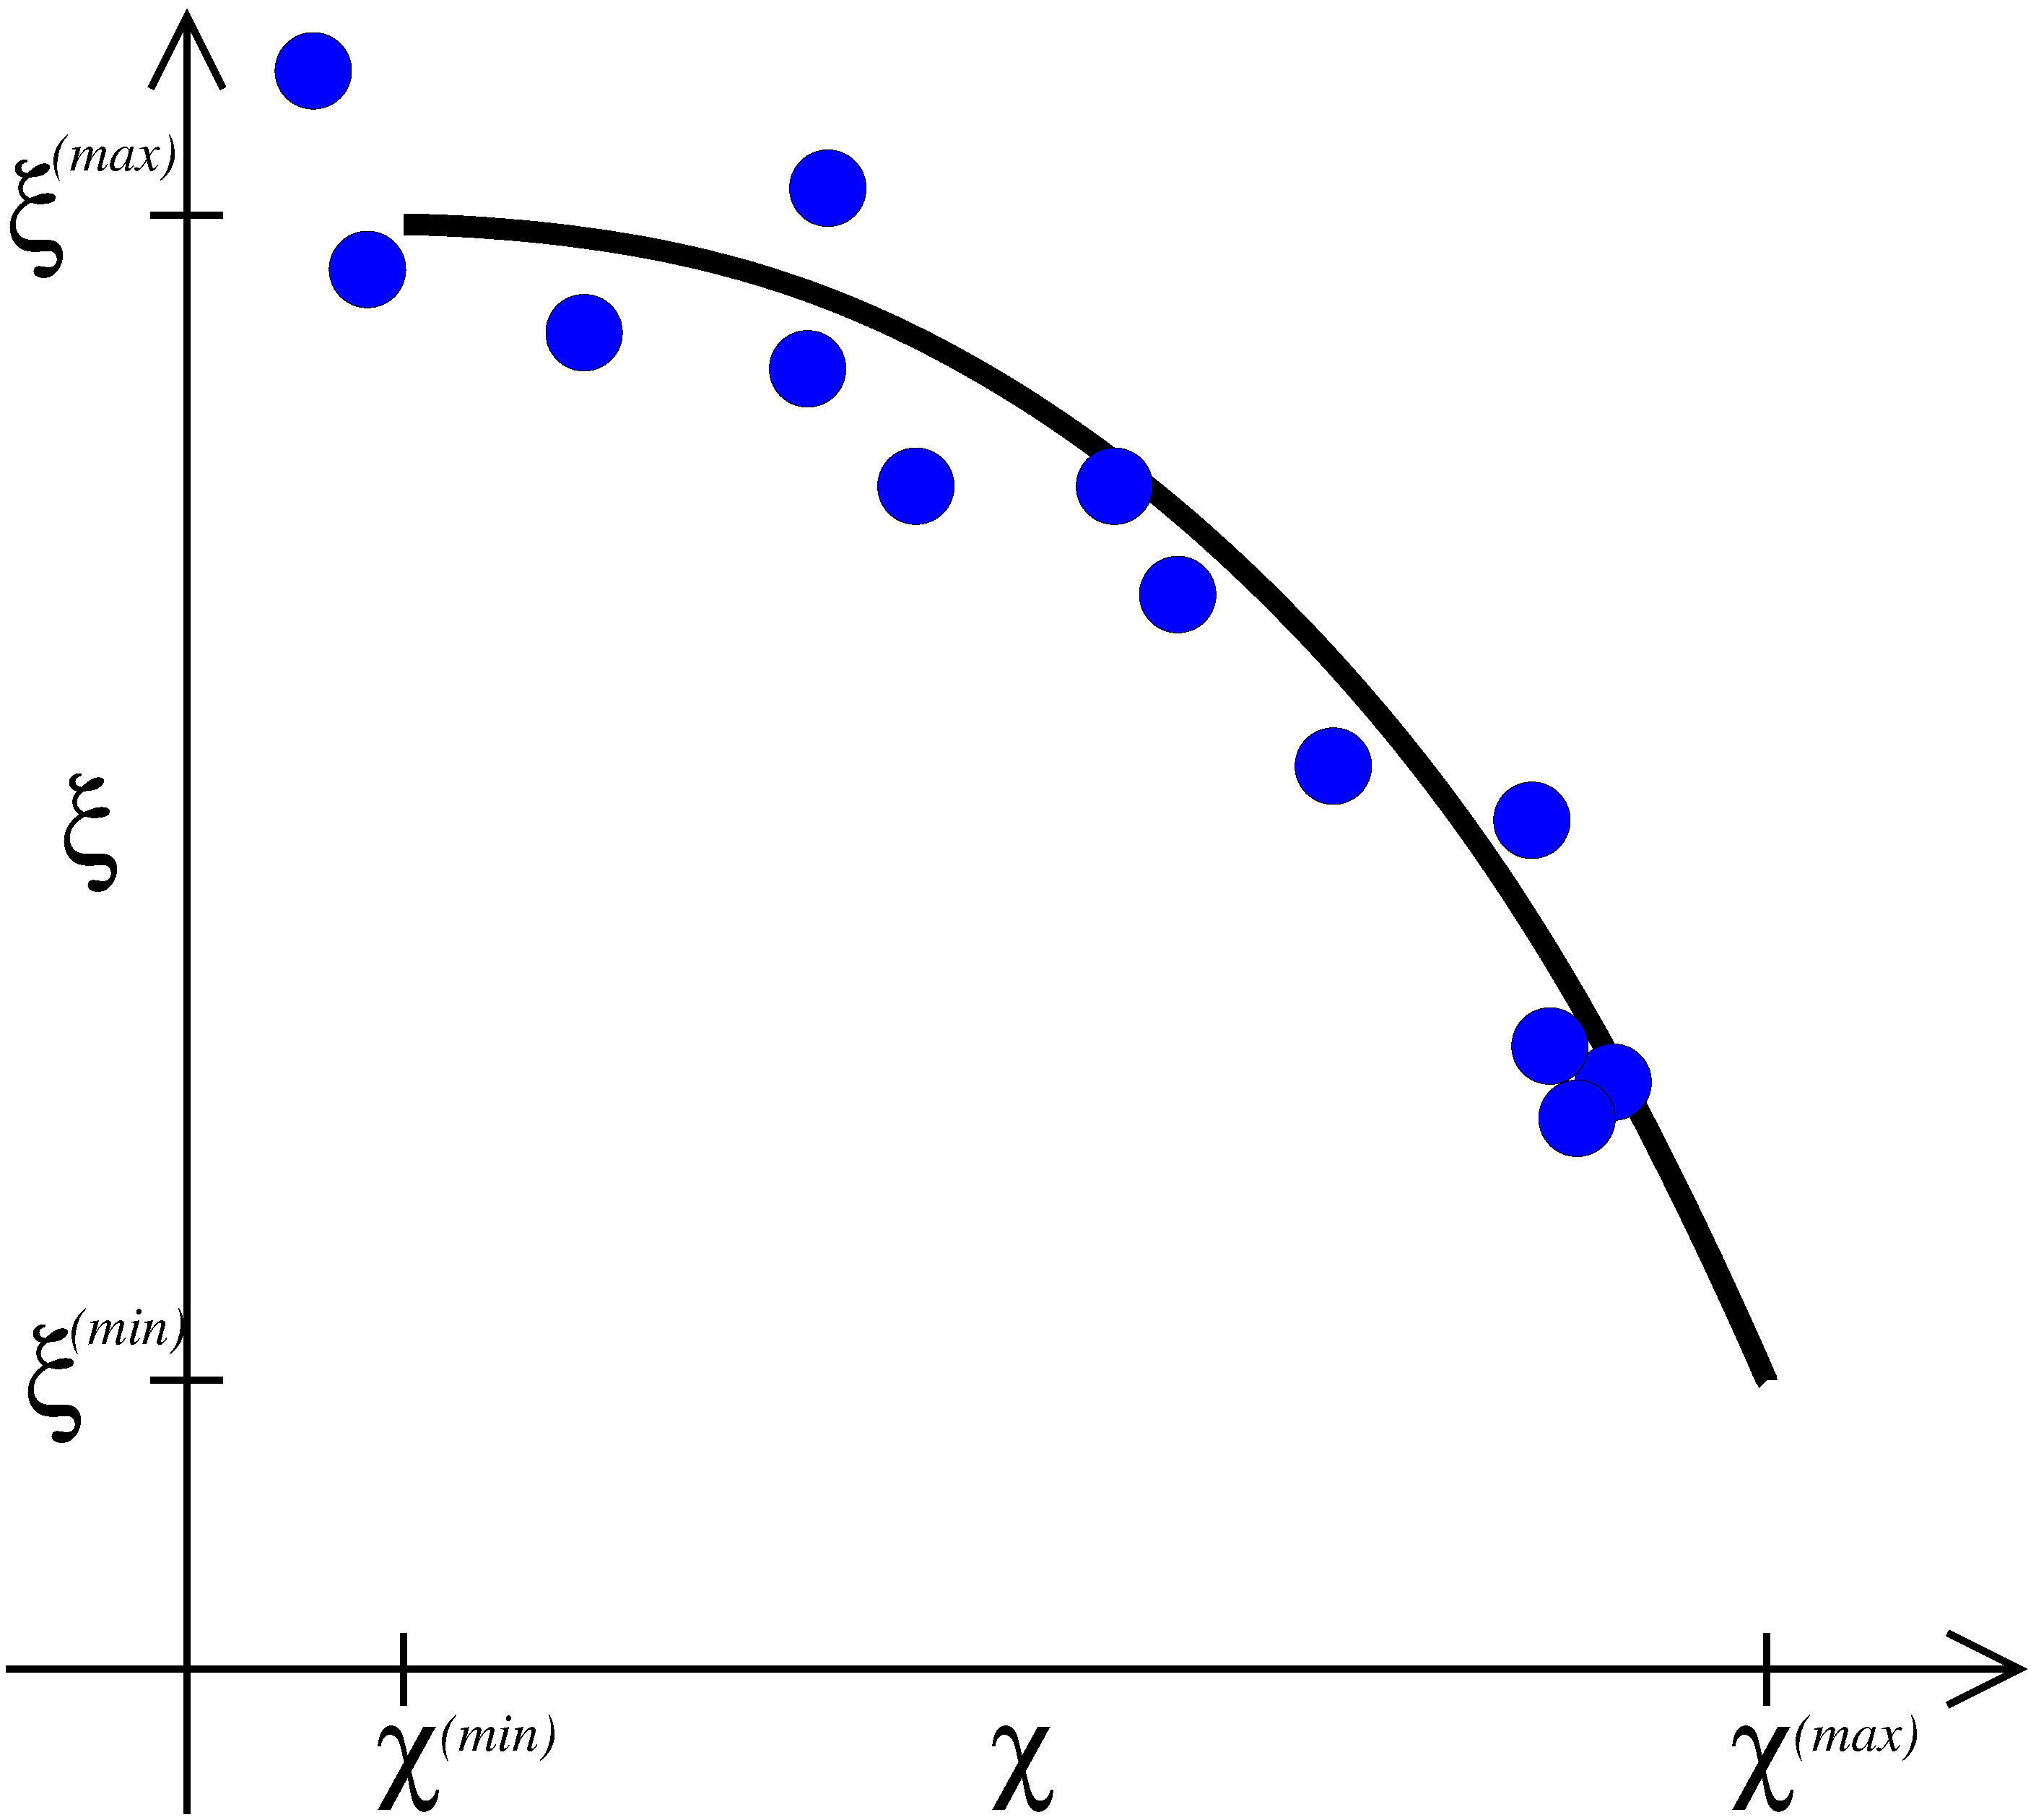
5. Preserving correlations
Initial conditions
tracer 1: cosine bells tracer 2: correlated cosine bells Ψ(χ)=aχ²+b
Truncation errors
can introduce
mixing
Lauritzen and Thuburn (2011,QJRMS)

Slide 54
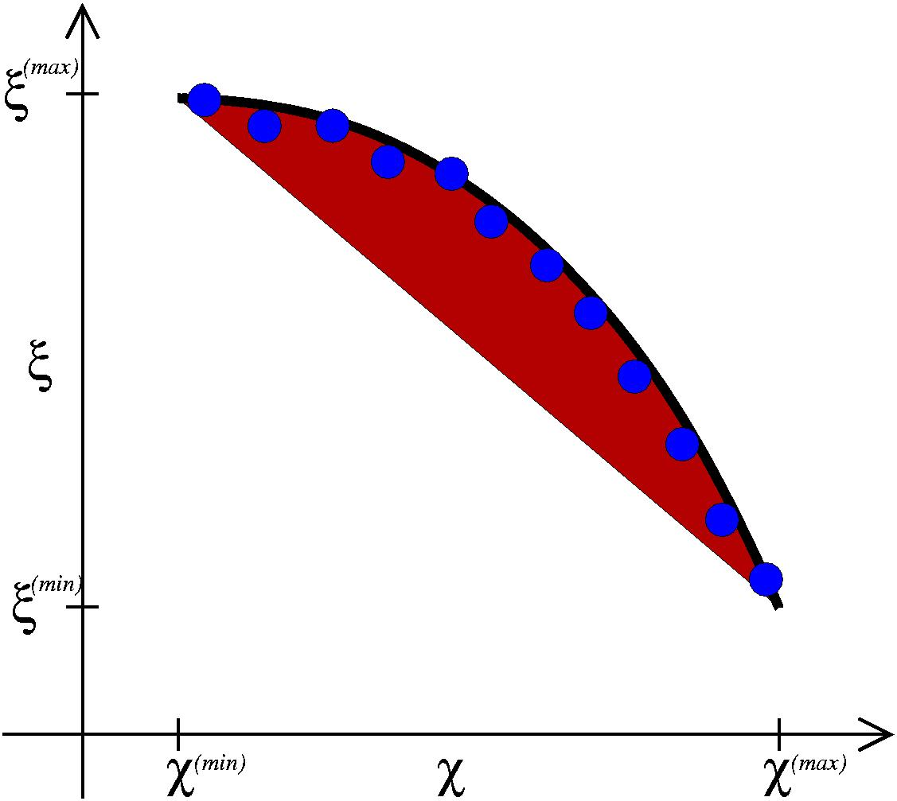
5. Preserving correlations
Classification of mixing on scatter plot:
a. Mixing that resembles `real’ mixing – convex hull (red area)
b. Everything else is spurious unmixing
Thuburn and McIntyre (1997,JGR)

Slide 55
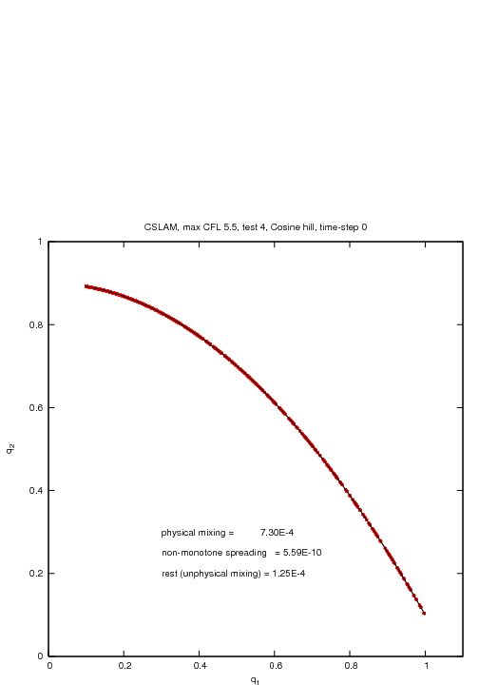
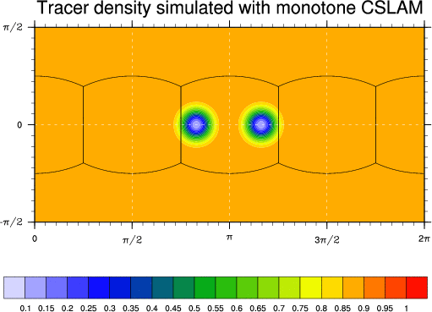
5. Preserving pre-existing functional relation between tracers under challenging flow conditions
Note: 1. Max value decrease, 2. Unmixing even if scheme is shape-preserving, 3. No expanding range unmixing

Slide 56
5. Preserving pre-existing functional relation between tracers under challenging flow conditions
Note: 1. Max value decrease, 2. Unmixing even if scheme is shape-preserving, 3. No expanding range unmixing

Slide 57
5. Preserving pre-existing functional relation between tracers under challenging flow conditions
Note: 1. Max value decrease, 2. Unmixing even if scheme is shape-preserving, 3. No expanding range unmixing

Slide 58
Cubed-sphere models

Slide 59
Cubed-sphere models

Slide 60
Reg. lat-lon models
Prather scheme
performs exceptionally
well
No data
No data
No data
No data
No data
No data
Shape-preserving
scheme
overshoots!
No data
No data

Slide 61
Icosahedral/Voronoi models

Slide 62
Quantifying mixing
This diagnostic does
not rely on an analytical
solution!
Lauritzen and Thuburn (2012, QJRMS)

Slide 63
Quantifying mixing: stacked histogram
(“real” mixing,range-preserving unmixing , overshooting)
For each scheme: left histogram is unlimited results; right is shape-preserving (sp)
Y-axis: Normalized by CSLAM unlimited mixing diagnostics at 1.5°

Slide 64
Quantifying mixing: stacked histogram
(“real” mixing,range-preserving unmixing , overshooting)
For each scheme: left histogram is unlimited results; right is shape-preserving (sp)
Y-axis: Normalized by CSLAM unlimited mixing diagnostics at 1.5°
If shape-preserving filter is “rigorous” red bars disappear: IMPORTANT!
Yellow histograms reduce with sp filter: scheme produces results that are more
physically realizable!
For some schemes `real mixing’ decreases and for some it increases with sp filter.

Slide 65
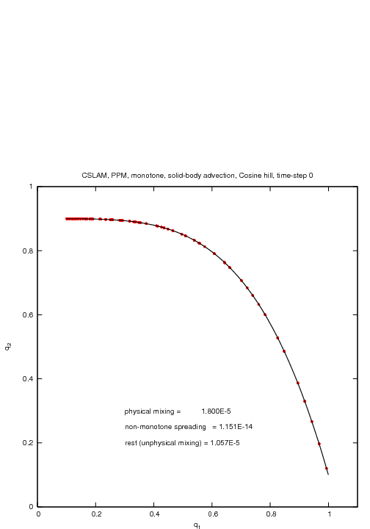
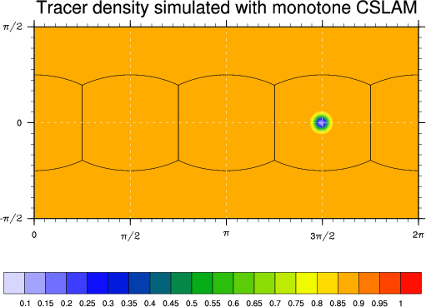
It is key that tracer features collapse to smaller scales (as in nature)
√∫
This setup uses a 4th-order non-linear relation Ψ(χ)=aχ⁴+b

Slide 66

√∫

Slide 67
References
Harris, L.M., P.H. Lauritzen and R. Mittal, 2011: A Flux-form version of the Conservative
Semi-Lagrangian Multi-tracer transport scheme (CSLAM) on the cubed sphere grid.
J. Comput. Phys.: Vol. 230, Issue 4, pp. 1215–1237
Lauritzen,P.H., R.D. Nair and PA. Ullrich, 2010: A conservative semi-Lagrangian multi-tracer
transport scheme (CSLAM) on the cubed-sphere grid. J. Comput. Phys.:
Vol. 229, Issue 5, pp. 1401–1424
Lauritzen, P.H., C. Erath and R. Mittal, 2011: On simplifying `incremental remap'-type transport
schemes. J. Comput. Phys.: Vol. 230, pp. 7957–7963.
Lauritzen, P.H., W.C. Skamarock, M.J. Prather and M.A. Taylor, 2012: A standard test case suite for
two-dimensional linear transport on the sphere. Geosci. Model Dev., Vol. 5, pp. 887-901
Lauritzen P.H. and J. Thuburn, 2012: Evaluating advection/transport schemes using interrelated
Tracers,scatter plots and numerical mixing diagnostics. Quart. J. Roy. Meteor. Soc.: Vol. 138,
pp. 906–918
Thuburn J., M.E. McIntyre, 1997. Numerical advection schemes, cross-isentropic random walks, and
correlations between chemical species. J. Geophys. Res. 120(D6): 6775–6797

