Slide 1
Applying a standing-travelling wave decomposition to the persistent ridge-trough over North America during winter 2013/14
Oliver Watt-Meyer
Paul Kushner
Department of Physics
University of Toronto
(currently ASP Graduate Visitor at NCAR)
MODES Workshop
NCAR, Boulder, CO
August 28, 2015

Slide 2
Introduction
2013/14 winter atmospheric circulation over North America dominated by a persistent ridge-trough
  Led to unusually cold temperatures over Central/Eastern N.A.
  Warm and dry conditions on west coast of U.S.
2013/14 NDJFM, 2m Temp anomaly
2013/14 NDJFM, Z500 anomaly
Temperature [°C]
Z [m]

Slide 3
Introduction
In addition, several cold air outbreaks occurred during the season, the strongest of which was on 7 Jan 2014
  Minimum daily temperature records set at many weather stations, e.g. New York, Chicago, Atlanta [Screen et al., in press]
7 January 2014, 2m Temp anomaly
7 January 2014, Z500 anomaly
Temperature [°C]
Z [m]
CENA (Central/Eastern North America)

Slide 4
Introduction
Several studies have examined causes of the seasonally-averaged anomalous circulation pattern [Wang et al., 2014; Hartmann, 2015]

Slide 5
Introduction
Several studies have examined causes of the seasonally-averaged anomalous circulation pattern [Wang et al., 2014; Hartmann, 2015]
Screen et al. [in press] focus on the 7 January 2014 event, and show its decreasing likelihood under global warming and Arctic sea ice loss scenarios

Slide 6
Introduction
Several studies have examined causes of the seasonally-averaged anomalous circulation pattern [Wang et al., 2014; Hartmann, 2015]
Screen et al. [in press] focus on the 7 January 2014 event, and show its decreasing likelihood under global warming and Arctic sea ice loss scenarios
I will use a spectral decomposition to distinguish quasi-stationary (i.e. standing) wave variability from synoptic (i.e. travelling) variability over the 2013/14 winter season, and quantify their relative importance for the 7 January 2014 cold air outbreak

Slide 7
Outline
Connect atmospheric circulation and surface temperature over North America
Extremes over last two winter seasons
Sub-seasonal evolution over 2013/14
Standing-travelling wave decomposition: theory and application to North American winter circulation
Conclusions

Slide 8
Data
NCEP-NCAR Reanalysis 1
  1958-2015, daily data
2m air temperature
  CENA (Central/Eastern North America): 70-100°W, 26-58°N, following Screen et al. [in press]
500hPa geopotential height (Z500)
  DCI (Dipole Circulation Index) to be defined shortly
Focus on extended winter season
  NDJFM

Slide 9
Circulation-temperature connection
Define Dipole Circulation Index (DCI) to represent strength of ridge-trough over North America:
NDJFM Z500 Climatology

Slide 10
Circulation-temperature connection
DCI is well correlated with CENA temperature on daily and interannual timescales
Correlation increases to r=-0.67 if data detrended
Daily correlation (over all NDJFM days) is r=-0.61
NDJFM-mean timeseries

Slide 11
Circulation-temperature connection
Correlations with the DCI:
Contours = ±0.1, ±0.2, ±0.3, etc.

Slide 12
Winter-mean extremes of the last 2 years
The last two winters had the 2nd and 3rd largest NDJFM-mean DCI since 1958/59
2013/14 was the coldest winter over the CENA region since 1958/59; 2014/15 the 6th coldest
Dipole Circulation Index
CENA temperature

Slide 13
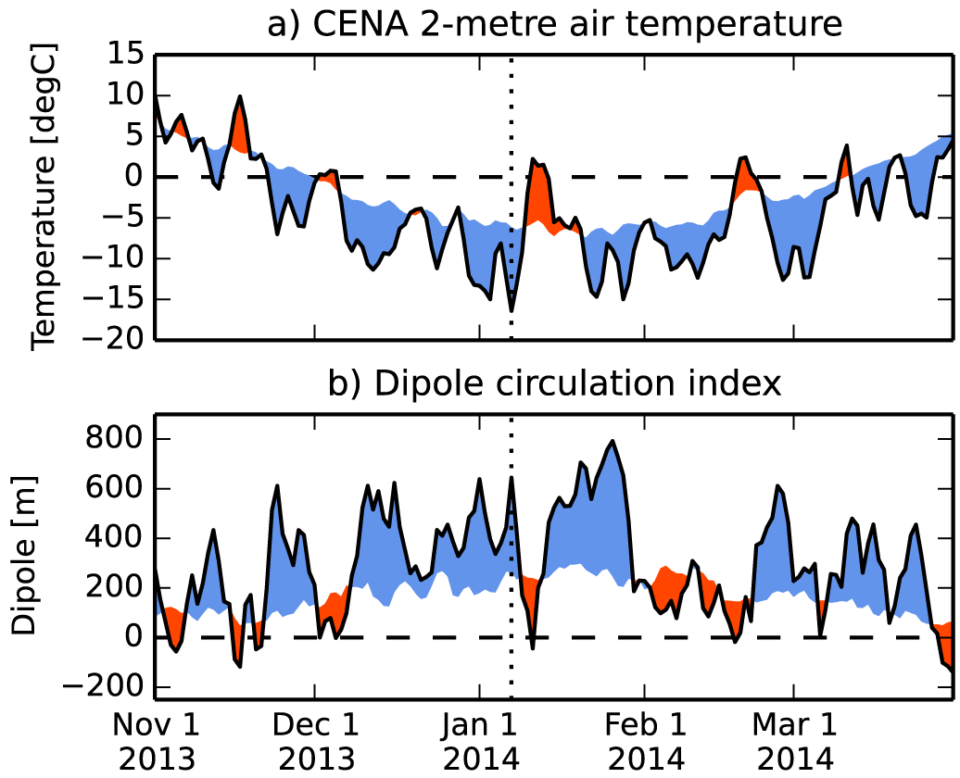
Sub-seasonal evolution for 2013/14
7 January,
2014
Climatology

Slide 14
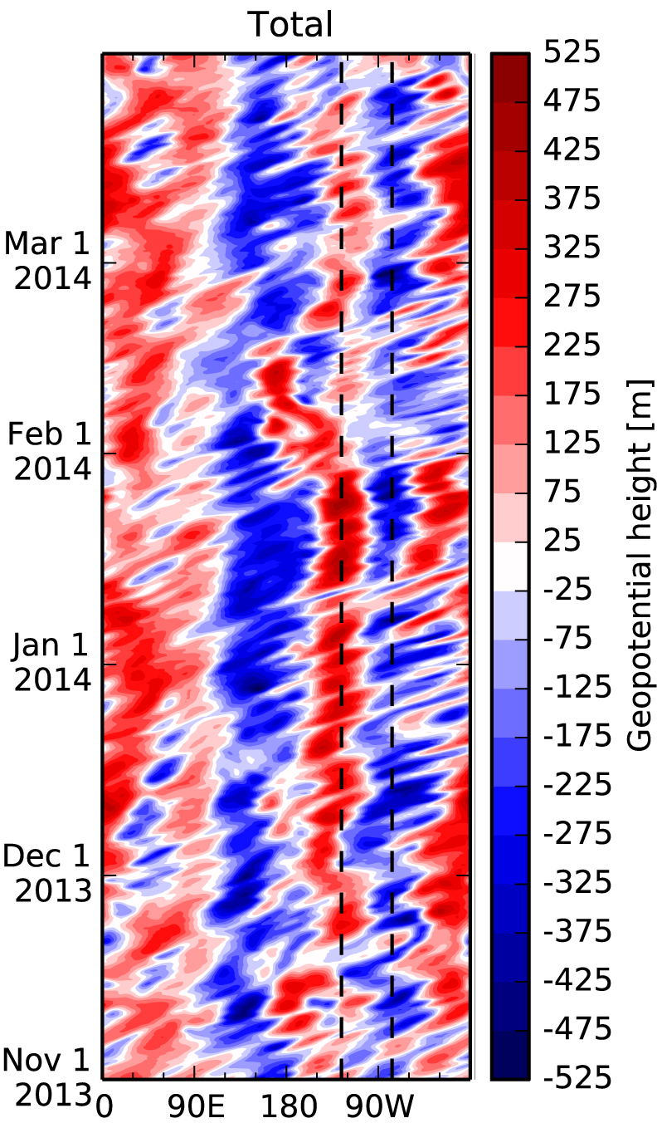
Sub-seasonal evolution for 2013/14
Zonal eddy of Z500 at 48°N for winter 2013/14
Large component of “quasi-stationary” variability
  This includes time-mean (ω=0) component and also some slow variability about it
Superimposed on this background are faster eastward travelling (synoptic) waves
Nodes of DCI

Slide 15
Standing-travelling wave decomposition

Slide 16
Standing-travelling wave decomposition
Using 2D discrete Fourier transform, write signal as:

Slide 17
Standing-travelling wave decomposition
Using 2D discrete Fourier transform, write signal as:
Then make a decomposition of into standing and travelling components:
This is motivated by:
Watt-Meyer and Kushner [2015]

Slide 18
Standing-travelling wave decomposition
Graphically:
Watt-Meyer and Kushner [2015]

Slide 19
Standing-travelling wave decomposition
Graphically:
Because standing and travelling waves are not orthogonal, there is no unique decomposition
Watt-Meyer and Kushner [2015]

Slide 20
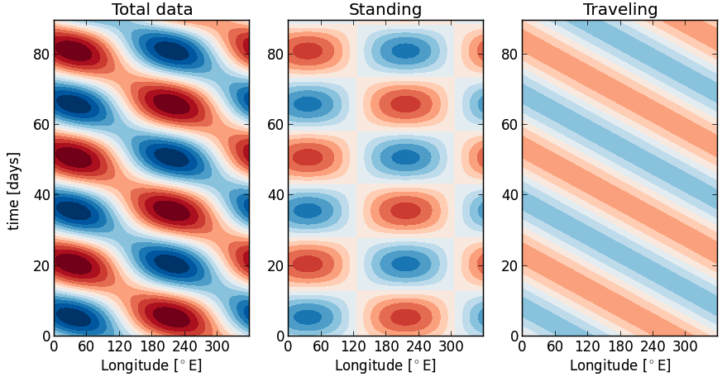
Standing-travelling wave decomposition
Toy example: wave-1, ω=±(1/30days)

Slide 21
Standing-travelling wave decomposition
Toy example: wave-1, ω=±(1/30days)

Slide 22
Variance explained
The power spectrum is decomposed as:
Variance of standing wave at
wavenumber , frequency
Variance of
travelling wave
Covariance of standing
and travelling waves

Slide 23
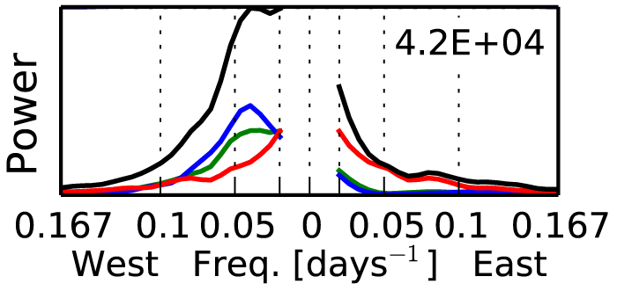
Variance explained
The power spectrum is decomposed as:
Variance of standing wave at
wavenumber , frequency
Variance of
travelling wave
Covariance of standing
and travelling waves
Example:
Wave-1
60°N
500hPa
NDJFM
Total
Standing
Travelling
Covariance
Power

Slide 24
Variance explained
Example: wave-1, 60°N, 100hPa, NDJFM 1979/1980
Historical methods do not explicitly account for the covariance between standing and travelling waves [Hayashi 1973, 1977, 1979; Pratt 1976]
Broadly speaking, our method recovers similar standing wave variance, but less travelling wave variance
Watt-Meyer and Kushner [2015]

Slide 25
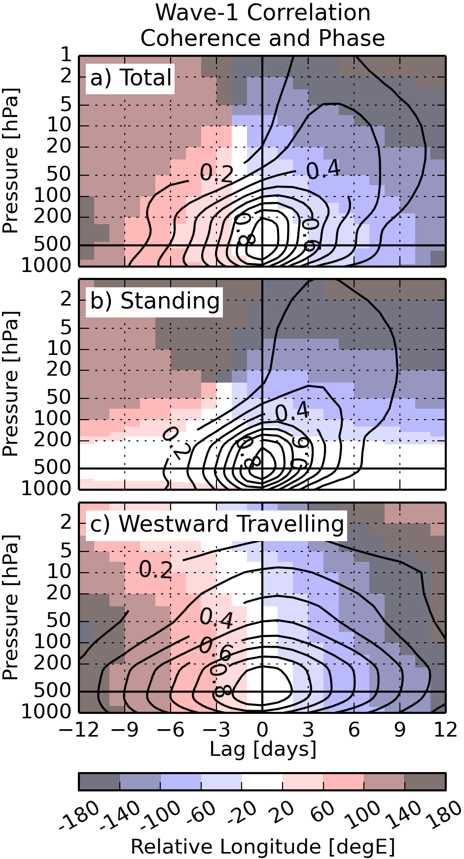
Wave 1 at 60°N
Lag coherence and phase between wave-1 at 60°N and 500hPa, and wave-1 at 60°N and other vertical levels [e.g. Randel, 1987]
Westward travelling wave-1… normal mode?
Watt-Meyer and Kushner [2015]

Slide 26
Correlations with DCI
Contours = ±0.1, ±0.2, ±0.3, etc.

Slide 27
Sub-seasonal evolution for 2013/14

Slide 28
Sub-seasonal evolution for 2013/14
7 January,
2014

Slide 29
Daily distribution of DCI for 2013/14
Grey: histogram of DCI over all NDJFM days
Red: histogram of DCI over 2013/14 NDJFM days
Vertical black line: value of DCI on 7 January 2014
Overall distribution of DCI shifted positive for 2013/14
Extreme large (above 99.9th percentile) eastward travelling DCI on 7 January 2014

Slide 30
Conclusions
Novel standing-travelling wave decomposition properly accounts for covariance between these wave types
  It also allows for straightforward reconstruction of real-space signals
Last two boreal winters had strong and persistent ridge-trough structure over North America, accompanied by cold temperatures over Central/Eastern North America
Record cold temperatures on 7 January 2014 driven by extreme high amplitude synoptic wave
For more details on spectral method:
O. Watt-Meyer and P. J. Kushner (2015), J. Atmos. Sci., 72, 787-802.

Slide 31
Extra slides

Slide 32
Extra slides

Slide 33
Extra slides

Slide 34
Extra slides

Slide 35
Extra slides

Slide 36
Extra slides

Slide 37
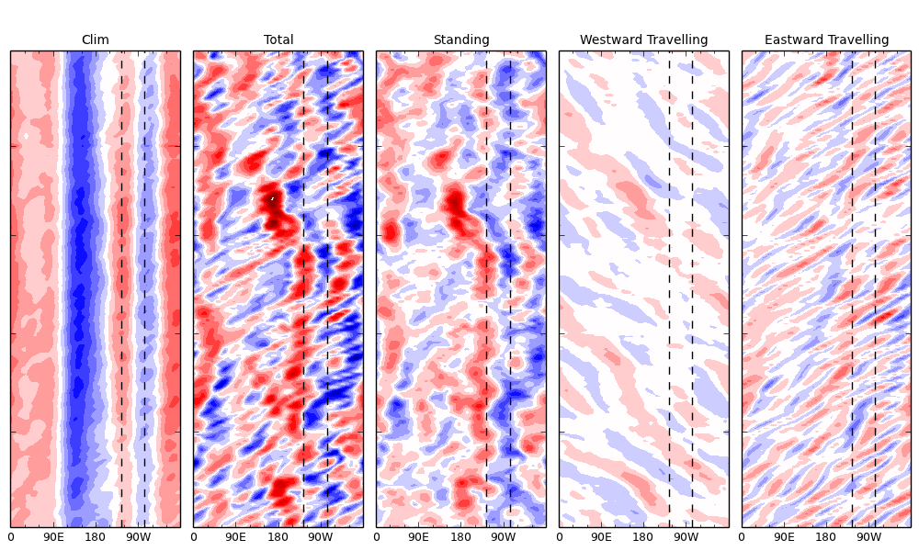
Extra slides
Climatology
Total Anomaly
Standing Anomaly
West Travelling
East Travelling

Slide 38
Sub-seasonal evolution for 2014/15
19 February,
2015

Slide 39
Daily distribution of DCI for 2014/5
Grey: histogram of DCI over all NDJFM days
Red: histogram of DCI over 2014/15 NDJFM days
Vertical black line: value of DCI on 19 February 2015

