Slide 1
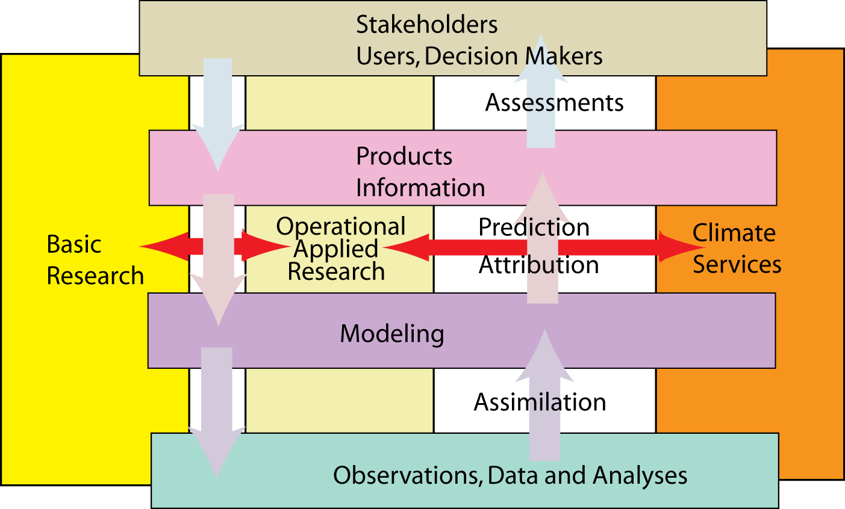
Aspects of a climate observing system: energy and water
Kevin E Trenberth
NCAR

Slide 2
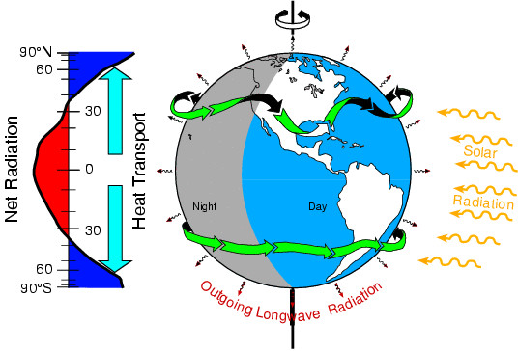
Tracking Earth’s Global Energy
Where has global warming from increased GHGs gone?
Kevin E Trenberth
NCAR

Slide 3
Where did the heat go?
2008 is the coolest year since 2000
Carbon dioxide continues to rise
Radiative forcing continues apace
Where did global warming go?

Slide 4
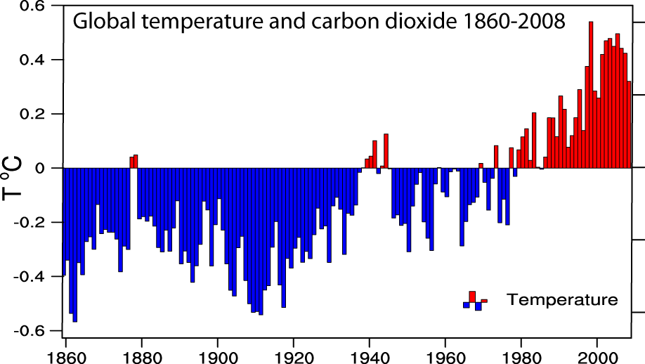
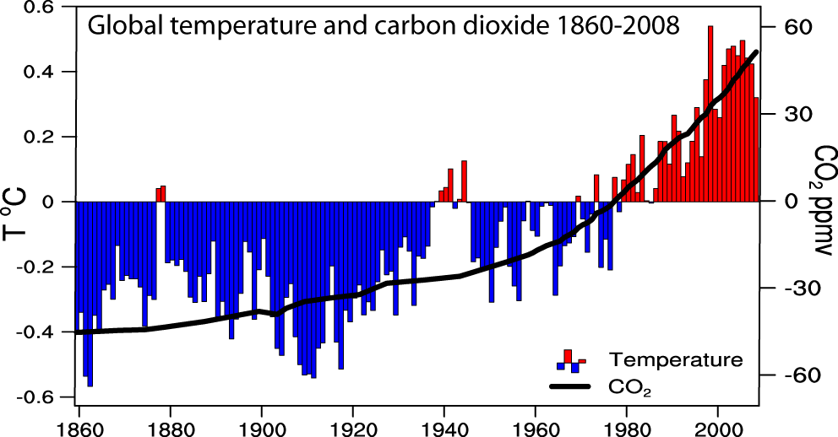
Global temperatures and carbon dioxide through 2008
Base period 1961-90

Slide 5
Global Temperature anomalies
Trend 1998 to 2008 is slightly positive but not significant.
Hadley Centre and CRU

Slide 6
Natural variability
We glibly answer that natural variability is the cause of the cooler year
After-all we did have a La Niña in 2007-2008
But where did the energy go?
We should be able to trace it!

Slide 7
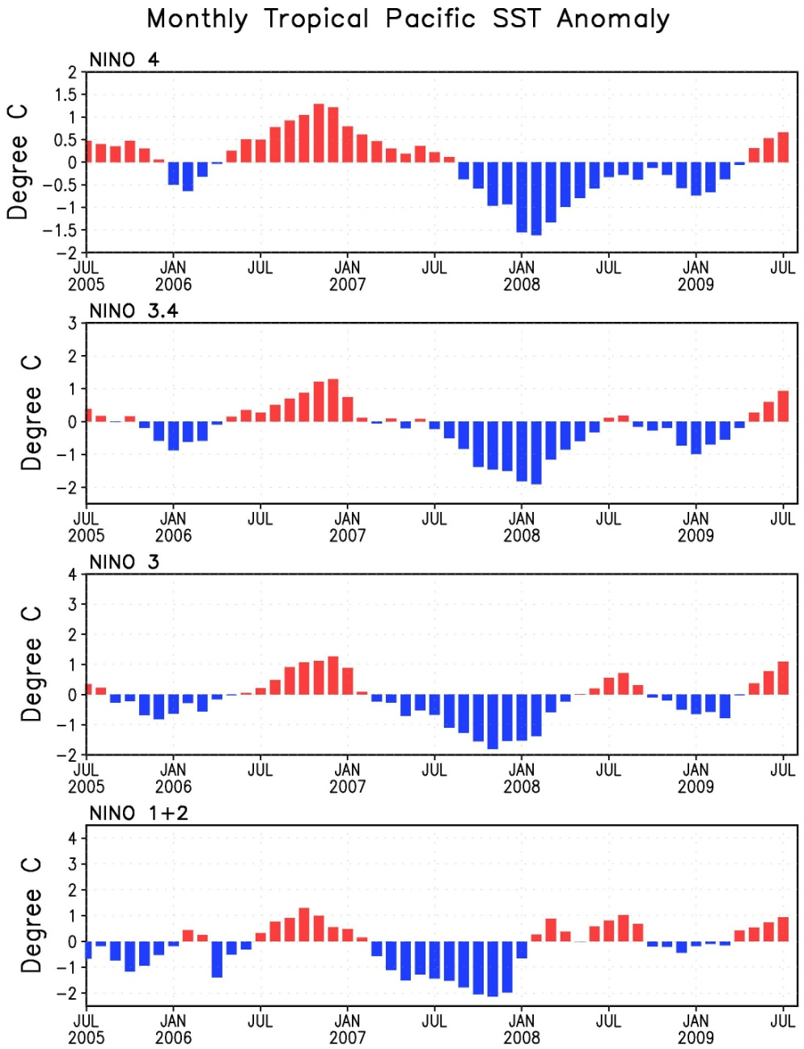
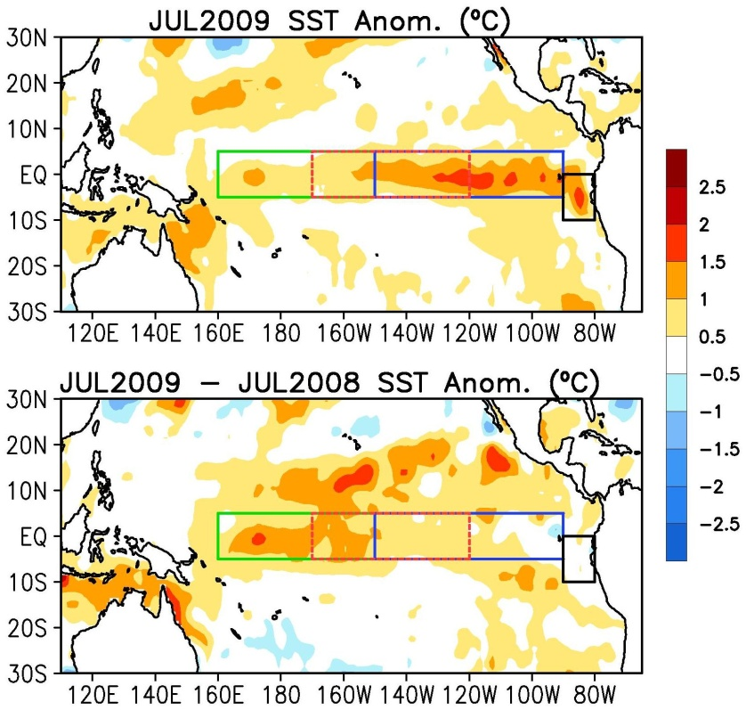
Evolution of Pacific NINO SST Indices
Nino 4
Nino 3.4
Nino 3
Nino 1+2
El Niño conditions
(NINO 3.4 > 0.5ºC) since June, are expected to last through the Northern Hemisphere Winter
All NINO indices increased in July 09.
Strong La Niña 2007-08
Returns weakly in 2008-09
Jan 2008 coldest month on land for long time
El Niño after June 2009
Nino region indices, as area-averaged monthly SST anomalies (ºC) as departures from 1971-2000 Climate Prediction Center

Slide 8
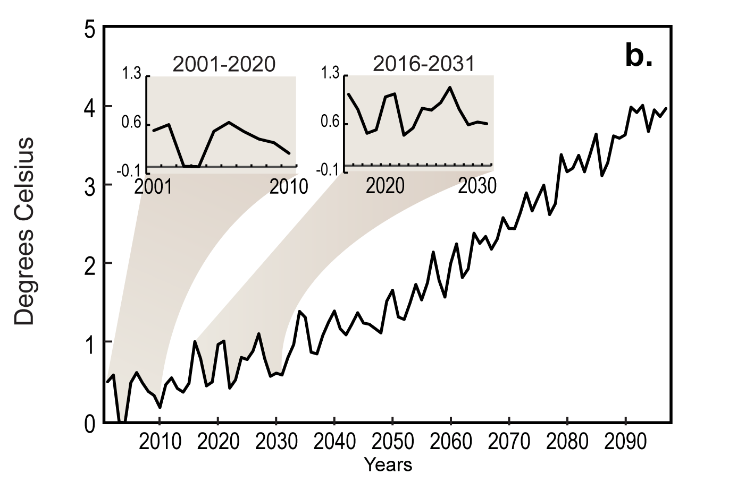
Cooling can easily happen for a decade or so Global Annual Surface Air Temperature,
MPI-ECHAM CGCM: A2 Forcing
Easterling et al 2009 GRL

Slide 9
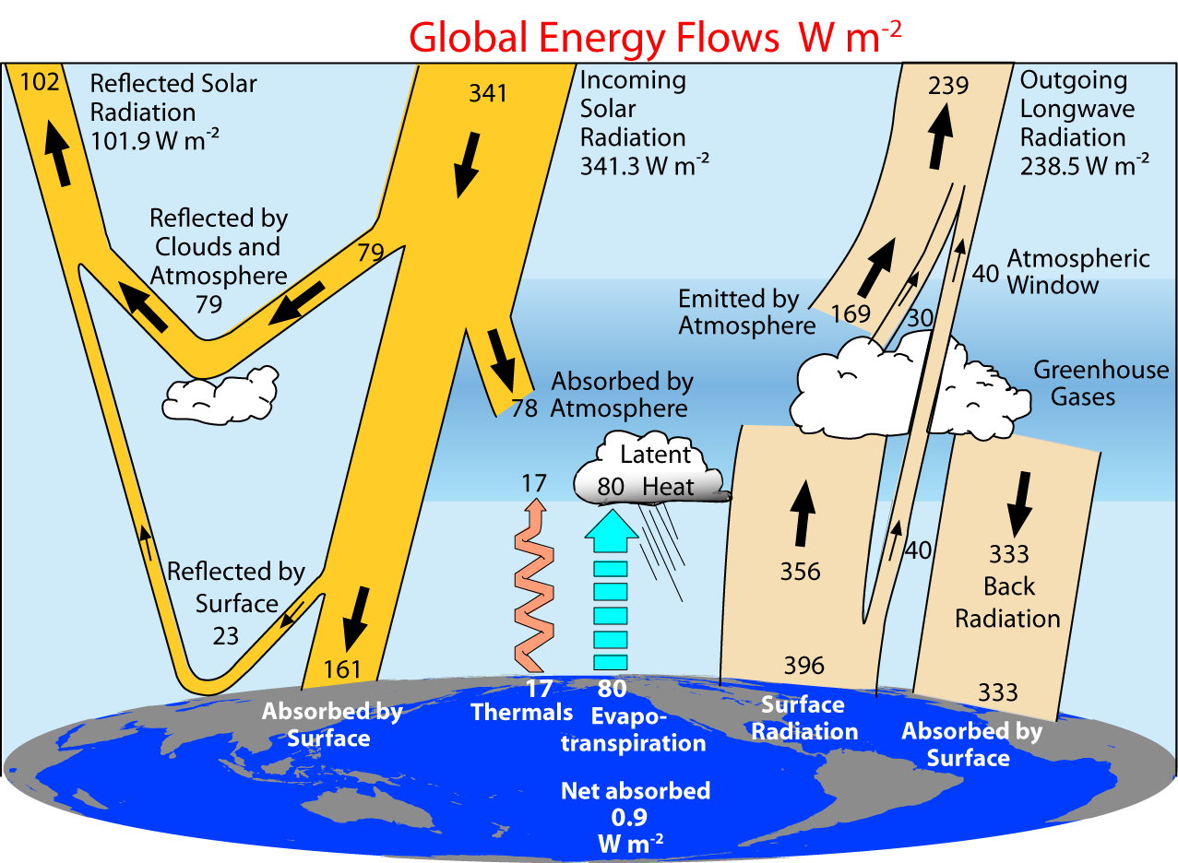
2000-2005 (CERES Period)
Trenberth et al 2009

Slide 10
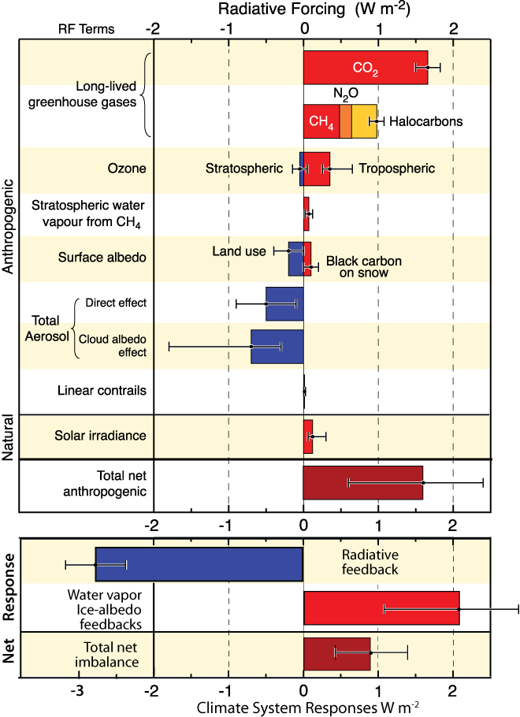
A warming climate has a cause:
Radiative Forcing and Response of Climate
Forcings W m⁻²
CO₂: 1.6
GHGs: 3.0
Aerosols: -1.4
Net: 1.6
Feedbacks
+Water vapor 2.1
+Ice-albedo
-Radiation -2.8
Net 0.9

Slide 11
Where does energy go?
Warms land and atmosphere
Heat storage in the ocean (sea level)
Melts land ice (sea level)
Melts sea ice and warms melted water
Evaporates moisture ⇒ cloud ⇒ reflection = lost to space
Can we track it?

Slide 12
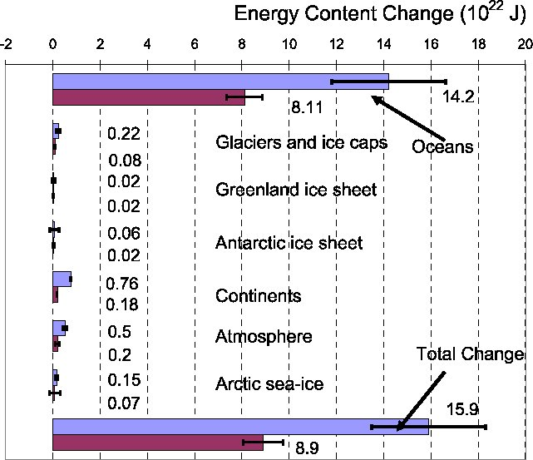
Energy content change 10²² J
Oceans
>90%
1961-2003 (Blue bars) Figure 5.4 IPCC AR4
1993-2003 (Burgundy bars)

Slide 13
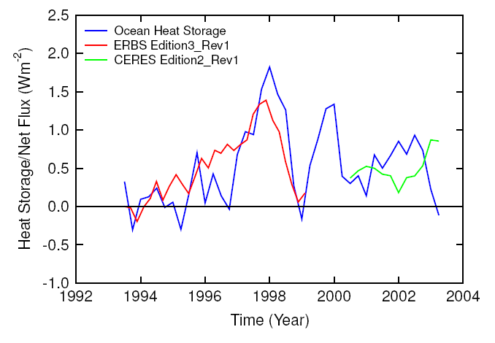
Matching ocean heat storage (Willis et al 04) and TOA radiation (Wong et al 06)

Slide 14
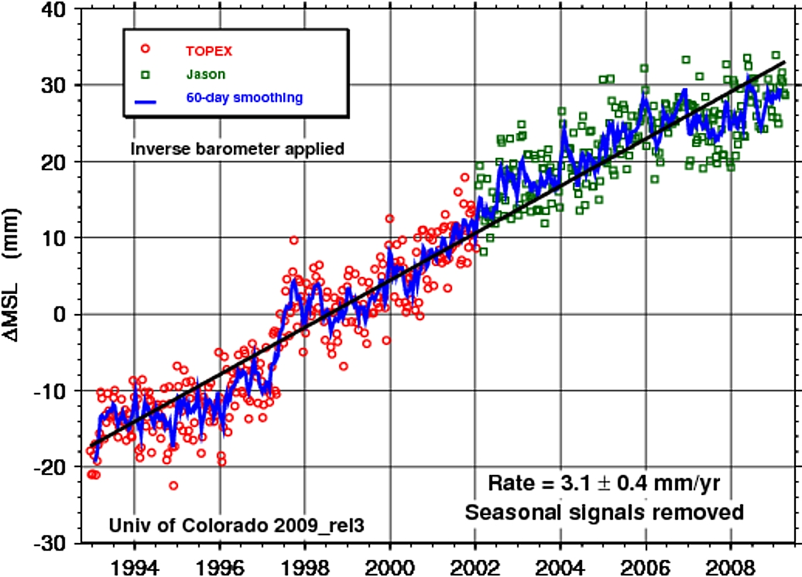
Sea level is rising:
from ocean expansion and melting glaciers
Since 1992
Global sea level
has risen 48 mm
(1.9 inches)
To 2003:
60% from
expansion as ocean temperatures rise,
40% from melting glaciers
Courtesy Steve Nerem
U Colo

Slide 15
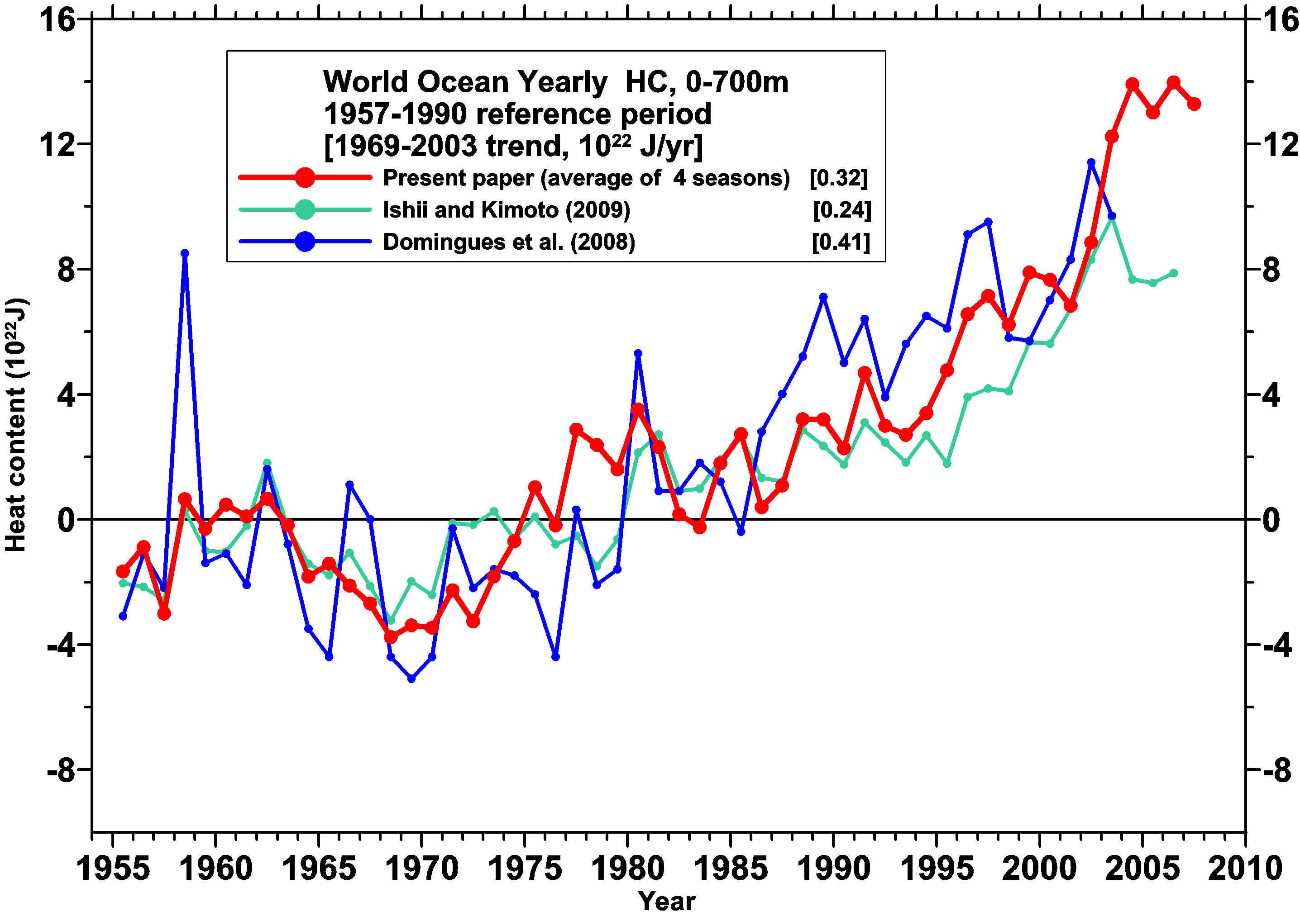
Revised ocean heat content
0.8 W m⁻²
0.3 W m⁻²
Levitus et al 2009
Yearly time series of ocean heat content (10²² J) for the 0-700 m layer from Levitus et al (2009), Domingues et al. (2008) and Ishii and Kimoto (2009) with a base period of 1957-1990. Linear trends for each series for 1969-2007 given in the upper portion of the figure.

Slide 16
What about 2003 to 2008?
2003 2008

Slide 17
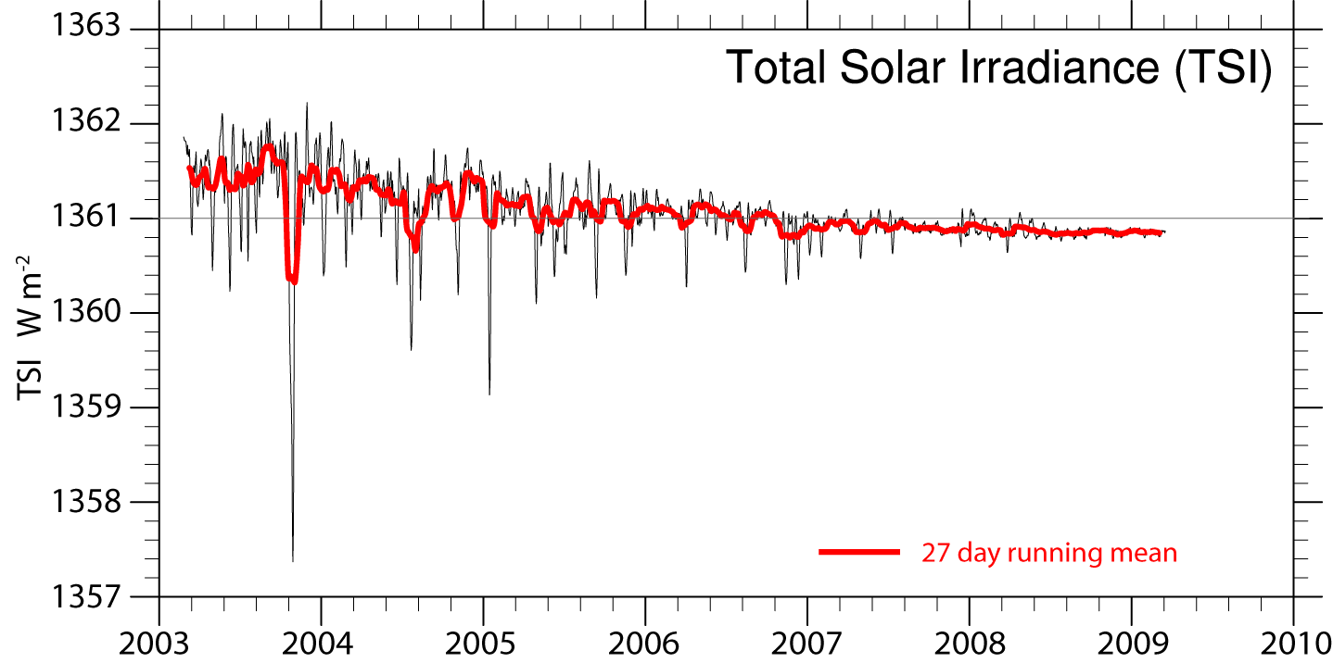
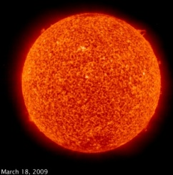
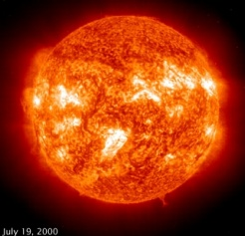
Solar irradiance
Drop of about 0.5 W m⁻² or
0.1 W m⁻² for radiative forcing
Total Irradiance Monitor (TIM) on the Solar Radiation and Climate Experiment (SORCE), U Colorado

Slide 18
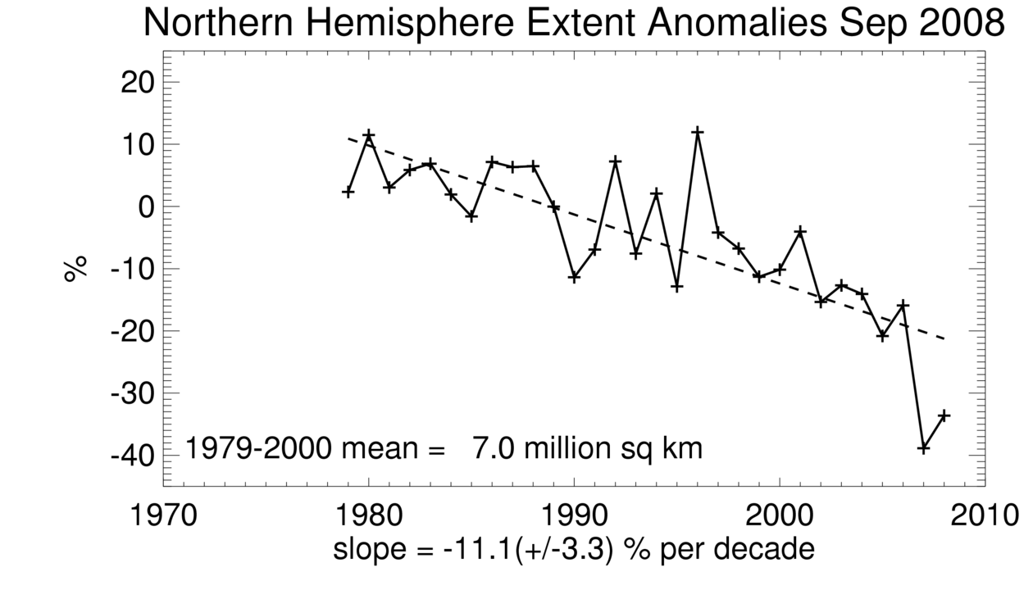
Snow cover and Arctic sea ice are decreasing
Arctic sea ice
area decreased by 2.7% per decade
(Summer: -7.4%/decade)
up to:
2007: 22% (10⁶ km²) lower than 2005
2008, second lowest
To melt 10⁶ km² ice 1 m thick (2007) to 10°C = 3.4x10²⁰ J
Globally per year since 2004 this is 0.02 W m⁻².
IPCC

Slide 19
Sea level
Anomalies
Altimeter
Argo
Ocean heat content =
Thermosteric
GRACE
Ocean mass sea level
Willis, Chambers, Nerem JGR 2008

Slide 20
Sea level 2003-2008
Sea level (altimetry) | 2.5 ±0.4
Ice sheets (GRACE) | 1 ± 0.15
Glaciers and ice caps (Meier et al., 2007) | 1.1 ± 0.24
Terrestrial waters | 0.17 ± 0.1
Sum of ice and waters | 2.2 ± 0.28
Sea level (altimetry minus GRACE) | 0.31 ± 0.15
Steric sea level (Argo; 04–08) | 0.37 ± 0.1
mm/yr Cazenave et al 2009 GPC.

Slide 21
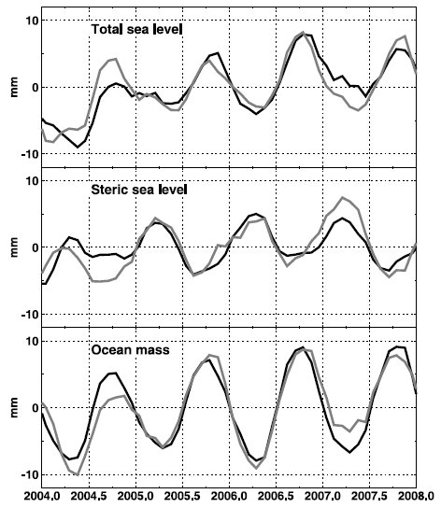
Sea level
Anomalies
Altimeter
Argo
Ocean heat content =
Thermosteric
GRACE
Ocean mass sea level
Leuliette and Miller 2009

Slide 22
ARGO
Sea level
Anomalies
Ocean heat content =
Thermosteric
Differences between
Leuliette and Miller 2009 and Willis et al 2008
-0.5± 0.5 mm/yr vs
+0.8± 0.8 mm.yr

Slide 23
Commentary
It is possible to reconcile recent changes in sea level.
Depends a lot (uncomfortably so) on Glacial Isostatic Adjustment in GRACE
Implication is that since 2003, main source of sea level rise is melting of Greenland and Antarctica, and glaciers.
These require about a factor of 50 less heat to produce same sea level rise as expansion
If correct, implies a slow down in ocean heat uptake and reduced TOA energy imbalance in past 4 years.
Does NOT solve energy imbalance problem.

Slide 24
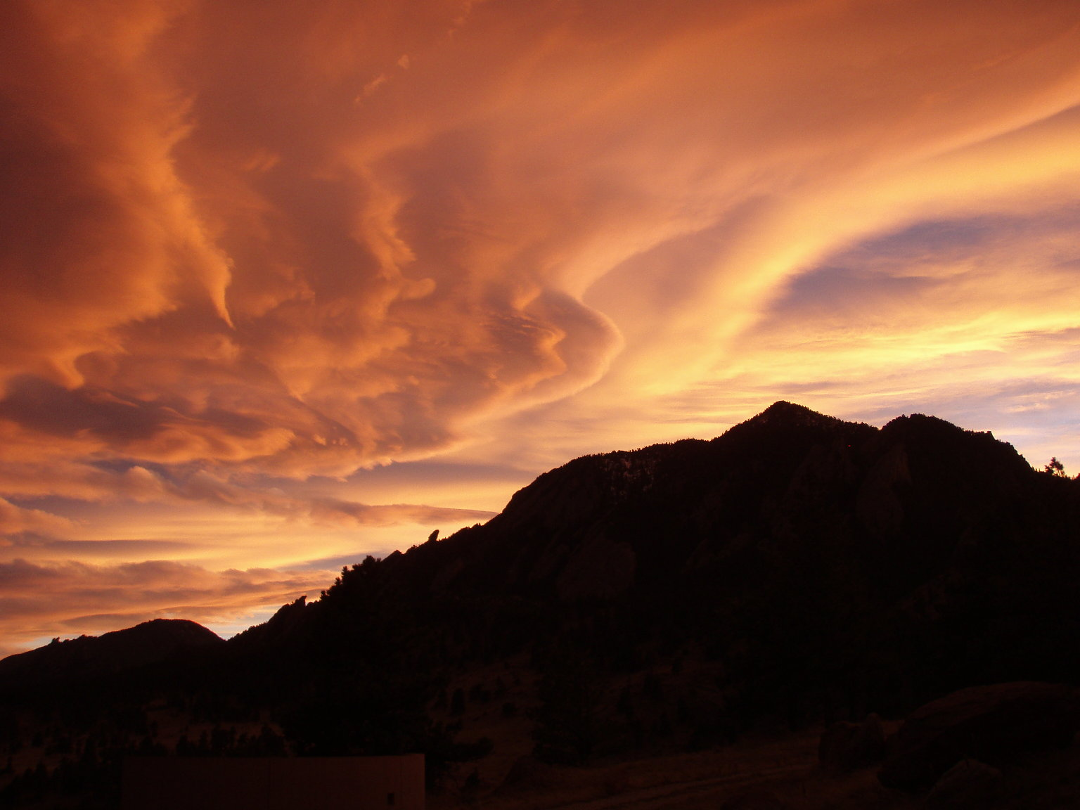
Need to know energy balance
What about clouds?
Cloud data (ISCCP, HIRS, Modis, etc)???
  ISCCP into 2007, but not homogeneous
CERES data on TOA radiation???
Some stuff available: Flashflux:
CERES plus MODIS clouds
http://eosweb.larc.nasa.gov/PRODOCS/flashflux/table_flashflux.html

Slide 25
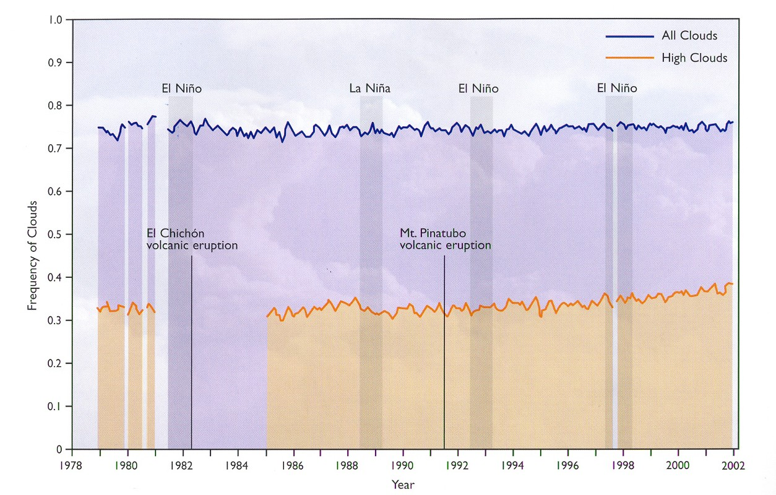
HIRS cloud amount trends
Wylie et al 2005

Slide 26
CERES data
1. QC official product to Oct 2005 (green)
2. CERES preliminary (yellow): MTSAT (Japan) problem begins Nov 2005
3. Flashflux data (pink); discon Jan 2008 in OLR
OLR
RSW
Net
Radiative Anomalies W m⁻²

Slide 27
Where does energy go?
10²⁰ Joules/yr

Slide 28
Need to know energy balance
A 1% increase in clouds is about -0.5 W m⁻²
Need reliable clouds and radiation data in closer to real time.
Is global warming continuing?

Slide 29
Geoengineering
Given that we can not adequately track what is going on now, what business have we even considering geoengineering?
  The intentional modification of climate
  Risk of serious side effects is real

Slide 30
Climate Information System
Trenberth 2008

Slide 31
Imperative
A climate information system
Observations: forcings, atmosphere, ocean, land
Analysis: comprehensive, integrated, products
Assimilation: model based, initialization
Attribution: understanding, causes
Assessment: global, regions, impacts, planning
Predictions: multiple time scales
Decision Making: impacts, adaptation
An Integrated Earth System Information System

