Slide 1
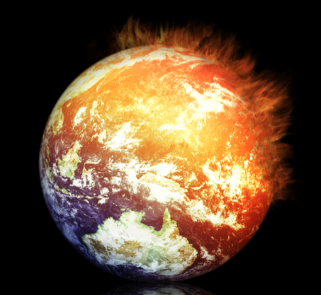
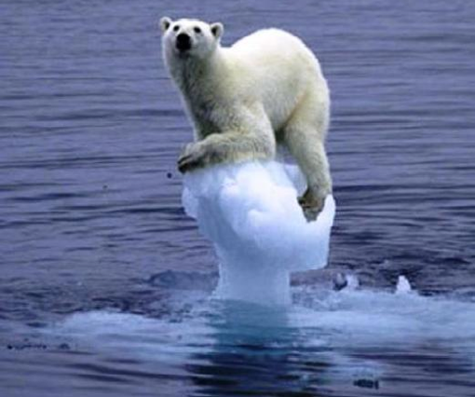
Changes in Extremes with Climate Change
Kevin E Trenberth
NCAR

Slide 2
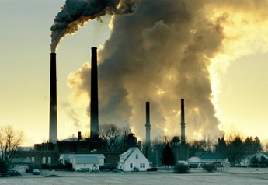

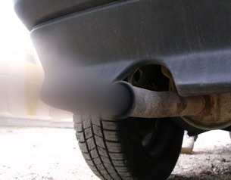
Climate change is happening:
It is due to humans
What we do about this problem involves value systems and politics!

Slide 3
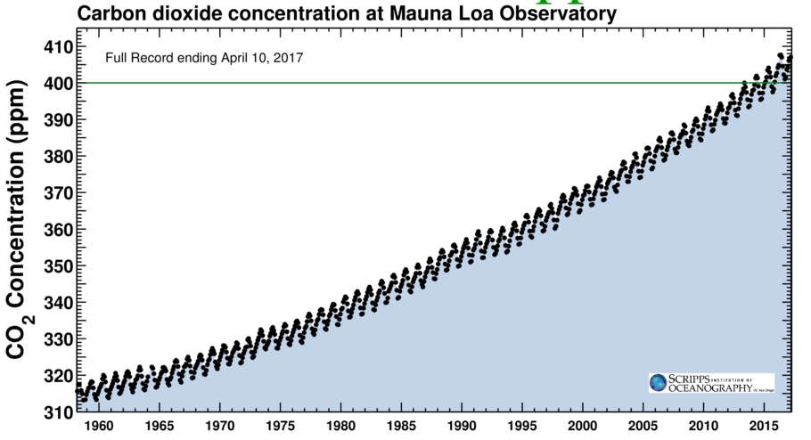
Changing atmospheric composition: CO₂
_{Mauna Loa, Hawaii}
Rate increasing
Data from Climate Monitoring and Diagnostics Lab., NOAA. Data prior to 1974 from C. Keeling, Scripps Inst. Oceanogr.

Slide 4
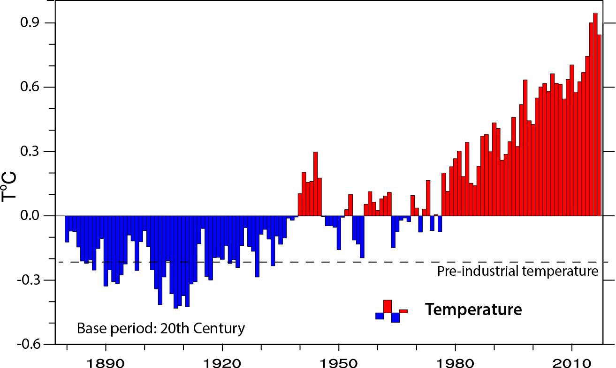
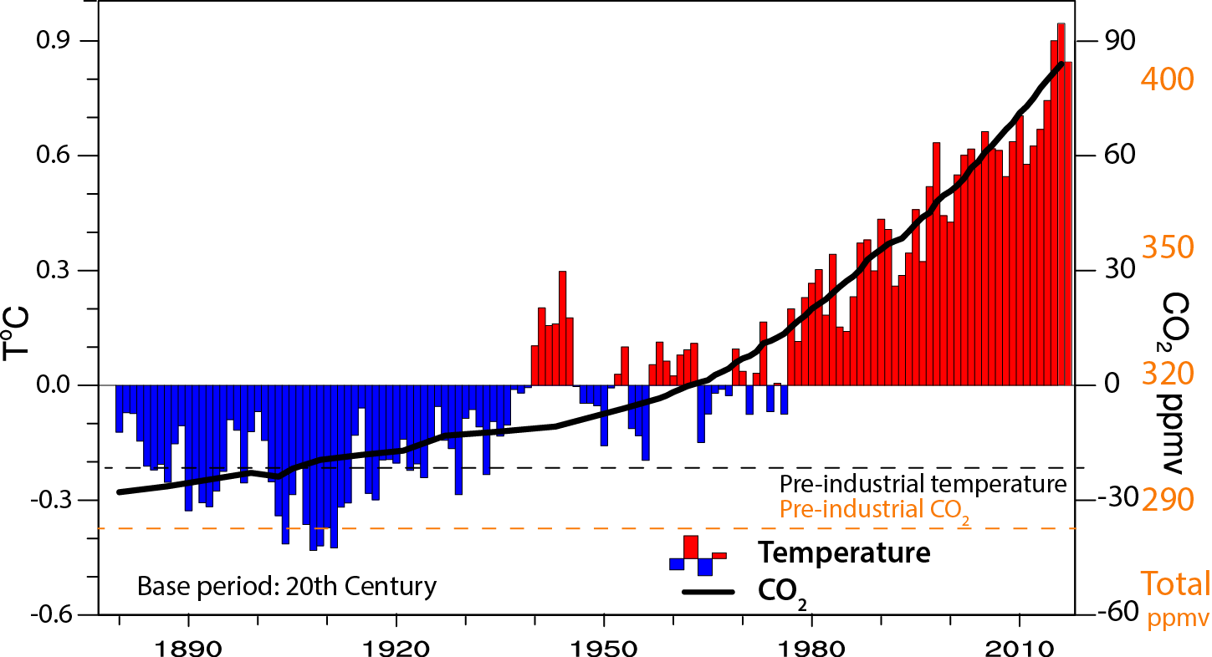
Global temperature and carbon dioxide: anomalies through 2017
1°F-
-1°F-
Base period 1900-99; data from NOAA

Slide 5
Energy on Earth
The climate is changing from increased GHGs.
We expect an energy imbalance from heat-trapping GHG.
The planet warms until OLR increases to match the ASR.
But there are many feedbacks and complexities.
The most fundamental measure that the climate is changing is the energy imbalance.
GHG: Greenhouse Gases
OLR: Outgoing Longwave Radiation
ASR: Absorbed Solar Radiation

Slide 6
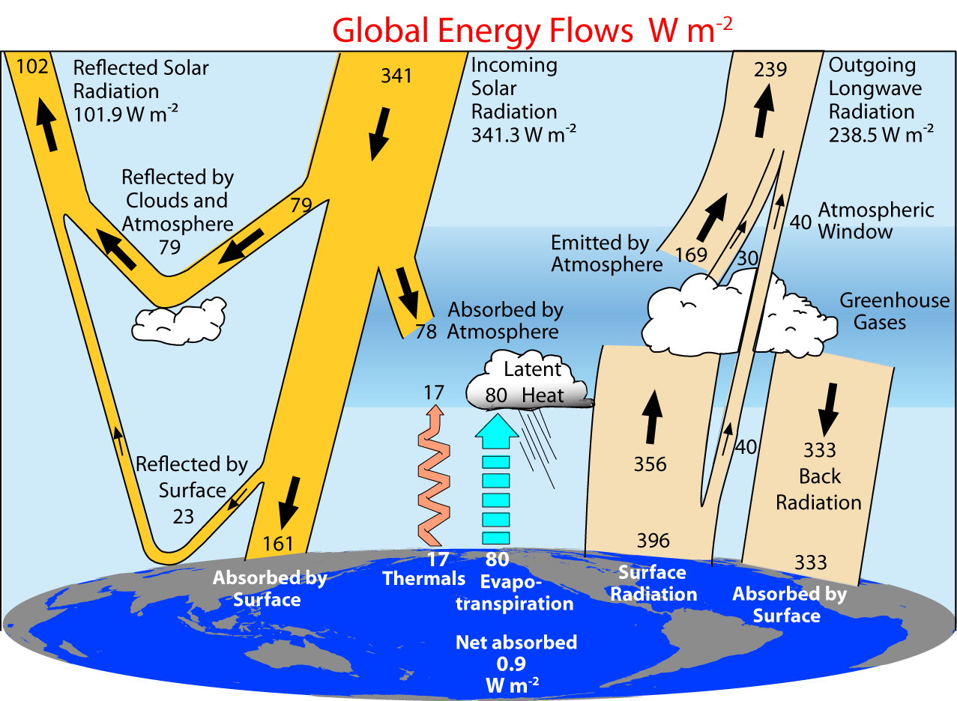
Trenberth et al (2009)

Slide 7
Earth’s Energy Imbalance
(net effect after all feedbacks included)
Varies over time but is now about:
1 W m⁻².
1 Christmas tree light is about 0.4 W.
This is over 5.1x10¹⁴ m² (area of Earth).
Hence the heating is about 0.5 PW (=500 TW).
[vs U.S. in 2014 electricity consumption was about 43x10¹⁰W]
[Germany 6.5x10¹⁰ W: Total order 1 TW: Factor of 500 less.]
The direct effects of humans is small:
except locally in cities.
It is mainly through interference with natural flows of energy that matters

Slide 8
Earth’s Energy Imbalance
(net effect after all feedbacks included)
1 W m⁻²
This is small at any time compared to natural flow of energy:
240 W m^{-2.}
So this is NOT how climate change is experienced.
Instead it has to accumulate, which it does under some circumstances, since it is always in the same direction.

Slide 9
Global warming means more heat:
Where does the heat go?
>90%
Warms land and atmosphere
Heat storage in the ocean (raises sea level)
Melts land ice (raises sea level)
Melts sea ice and warms melted water
Evaporates moisture ⇒ rain storms, cloud ⇒ possibly reflection of sun’s rays to space

Slide 10

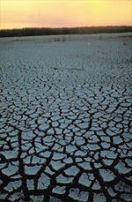
Controlling Heat
Human body: sweats
Homes: Evaporative coolers (swamp coolers)
Planet Earth: Evaporation (if moisture available)
e.g., When sun comes out after showers,
the first thing that happens is that the puddles dry up:
before the temperature increases.

Slide 11
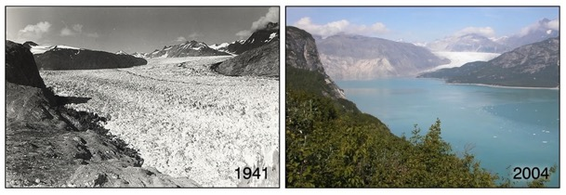
Effects accumulate in melted ice
Increased Glacier retreat since the early 1990s
Muir Glacier, Alaska
Arctic sea ice loss: over 40% in summer

Slide 12
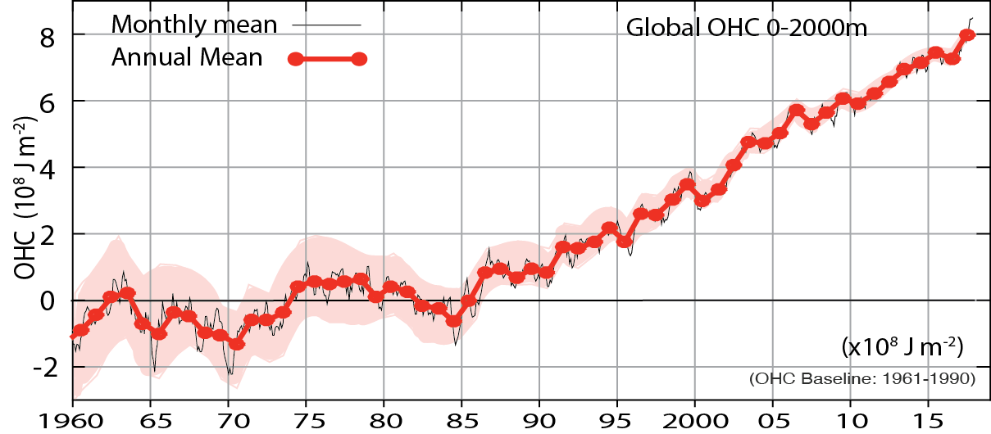
Ocean Heat Content
Updated from
Cheng et al 2017
Through 2017

Slide 13
A consequence of glacier melt and ocean heating: Sea Level Rise
3 inches

Slide 14
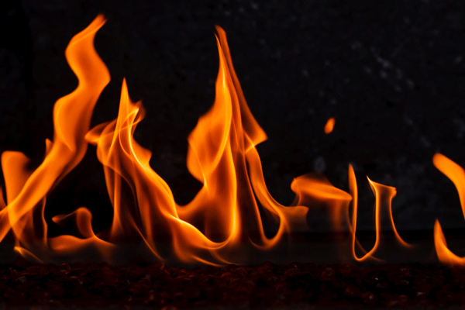
What about land?
If land is wet: heat goes into evaporation.
But in a drought, the heat accumulates.
Drying
Heating
1 W m⁻² over a month, if accumulated, is equivalent to
720 W m⁻² over 1 hour.
720 W is equivalent to full power in a small microwave oven.
1 m² is 10 sq ft
=> 1 microwave oven at full power every square foot for 6 minutes:
No wonder things catch on fire!

Slide 15
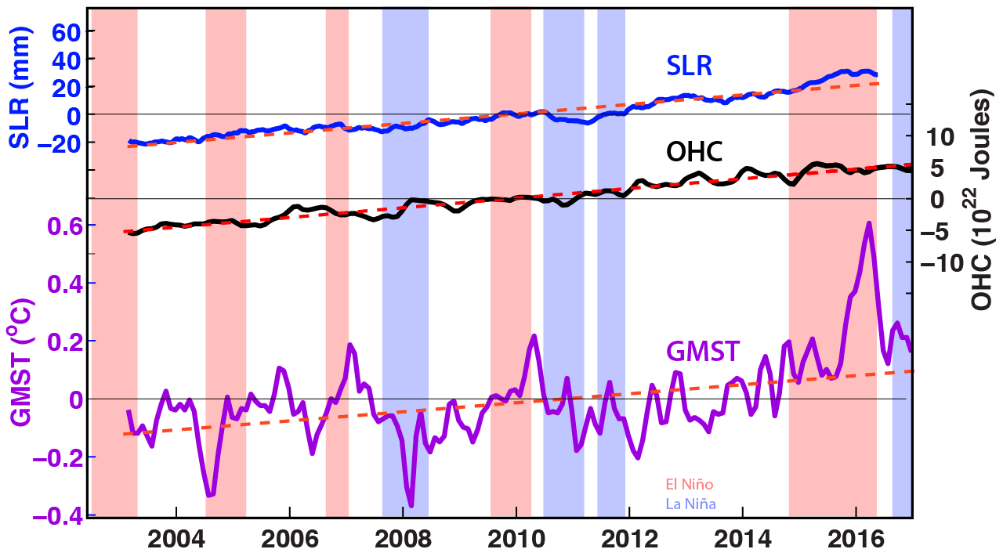
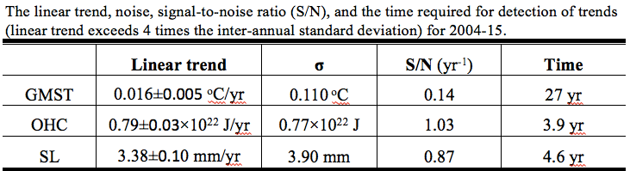
detrended
Cheng et al. 2018, Eos

Slide 16
Is it global warming?
Is it natural variability?
These are not the right questions: do not have answers.
Instead it is always a combination of both.

Slide 17
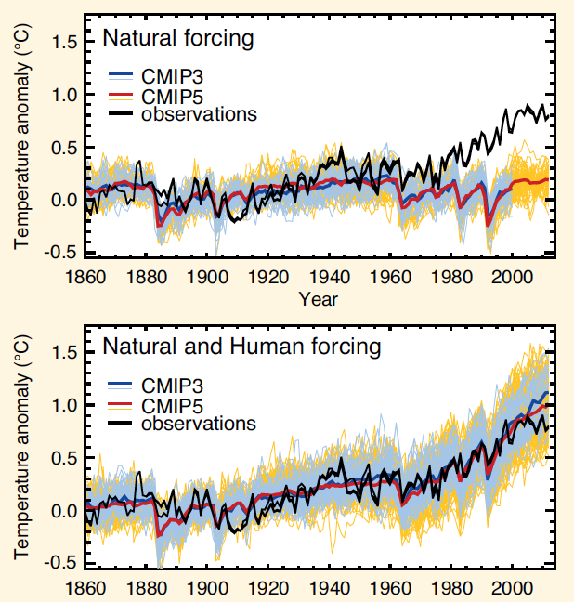
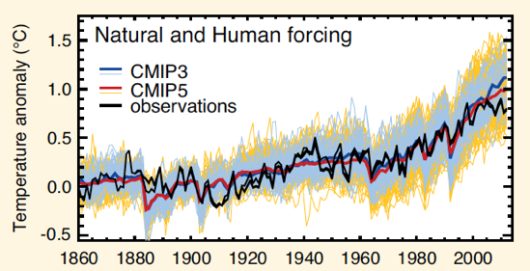
Attribution of climate change
With climate models, scientists can play “God”.
We can run models with and without human influences and see what the difference is.
Global surface temperature
IPCC 2013

Slide 18
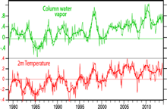

Dynamics vs thermodynamics
Phenomena:
Movement
Development
Chaotic (unpredictable)
Unique
Environment:
Temperature
Water vapor
Sea level
Robust (predictable)
The environment for all storms has changed:
Warmer by >1°F,
Moister by 5-10%
Ocean Heat Content is much higher
Sea level is higher by 19 cm
Supported by the huge memory and thermal inertia of the oceans:
Ocean Heat Content

Slide 19

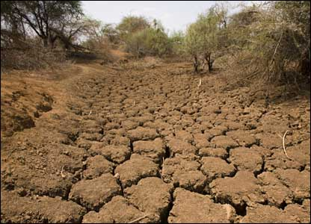
Warmer air holds more moisture
7% per °C =4% per °F
Global warming=
More heat
⇓
More drying
⇓
More evaporation
⇓
More moisture
More rain
More drought

Slide 20
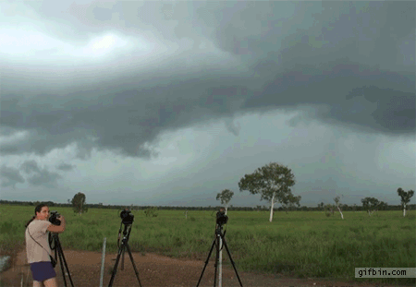
Take a parcel of air:
When it rises
(for whatever reason),
it expands and cools,
and any moisture in it condenses
and forms a cloud,
and then it rains the moisture out.

Slide 21
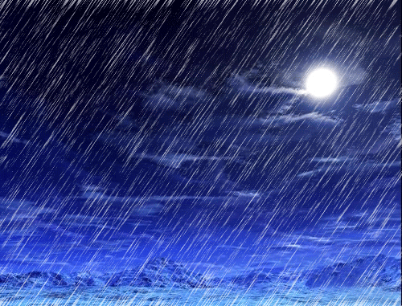

Slide 22
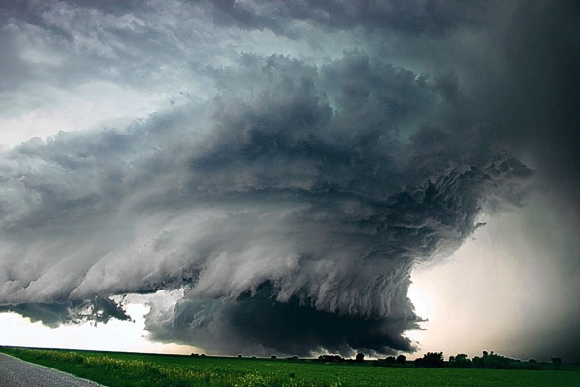
Most precipitation comes from moisture convergence by weather systems
Low level winds bring in moisture from afar
More moisture means heavier rains

Slide 23
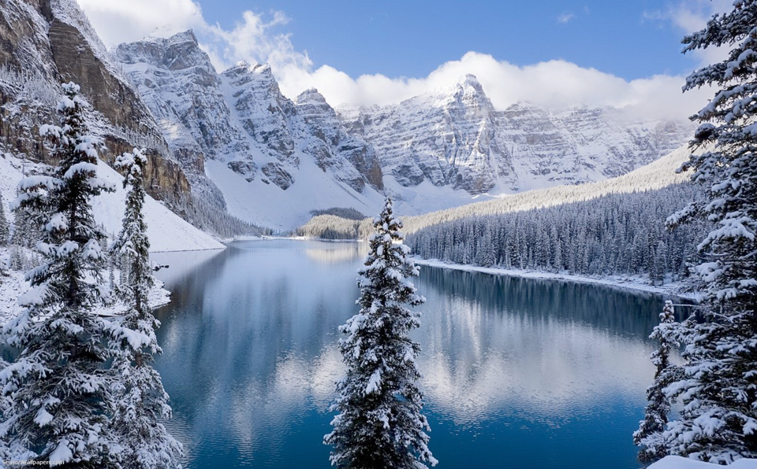
Mountains and climate change
Continental climate: strong seasons continue
Snow falls if temperature below about 35°F
  Greatest amounts 28-32°F
  “Too cold to snow”: freeze dried air
So more snow is a result of a warming climate
  unless it is so warm it turns to rain.
Glaciers retreat: amplifies changes (snow feedback)
More snow in mid-winter
Snow melt sooner, runoff earlier: Less snowpack
Prospects for less water in summer
Greater risk of drought, heat waves, wild fires
Expansion of pests (Like bark beetle)
Imgpot.com

Slide 24
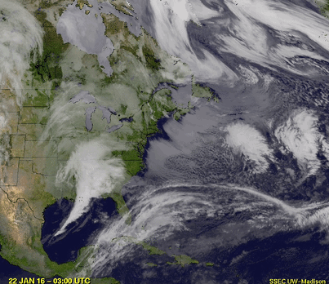
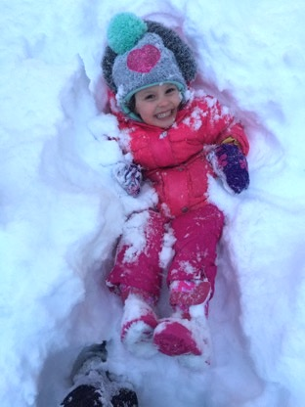
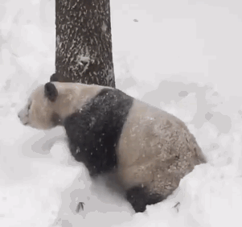
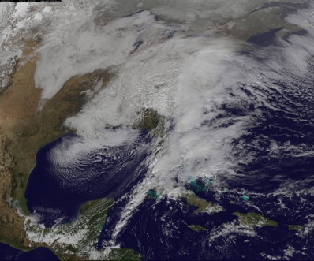
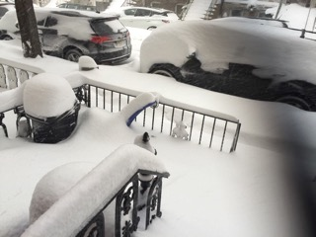
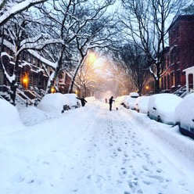
Jonas: East coast snow storm
Jan 22-23 2016

Slide 25
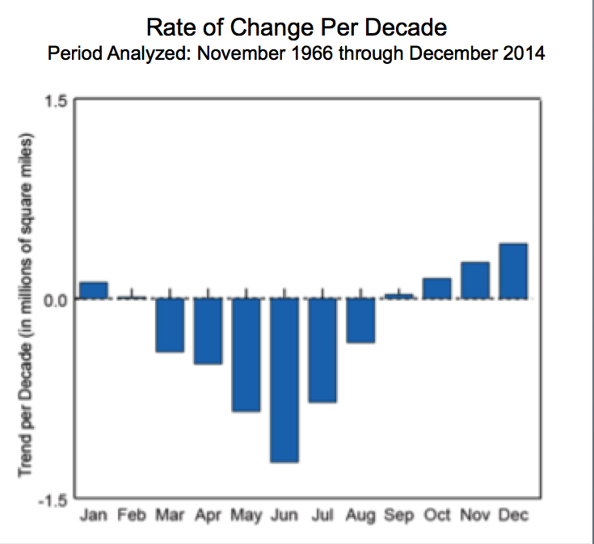
Northern Hemisphere snow cover extent
27 Jan 2015 NOAA

Slide 26
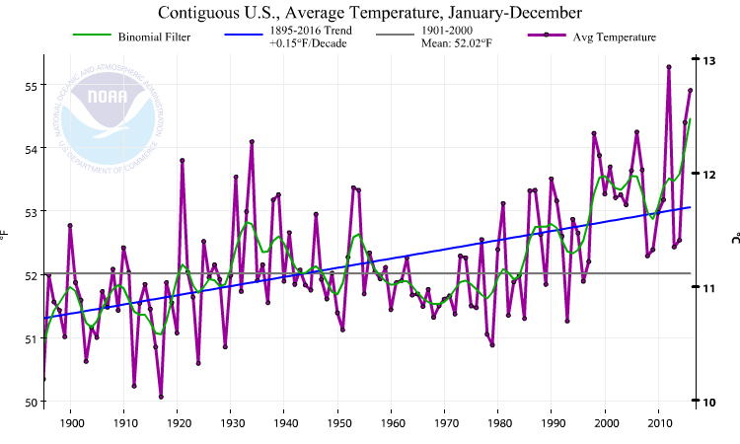
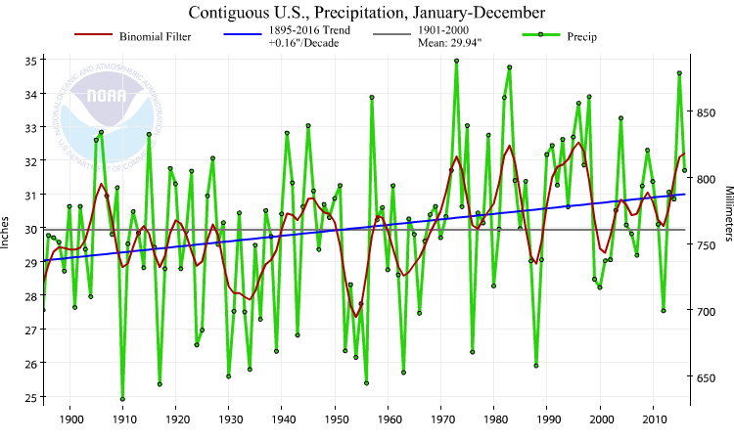
US 48 contiguous States
Temperature: annual
Precipitation:
Annual
Thru 2016,
Temp
Precip
Much wetter
*
2012:
V hot and dry
1930s:
Hot and dry
“Dust Bowl”

Slide 27
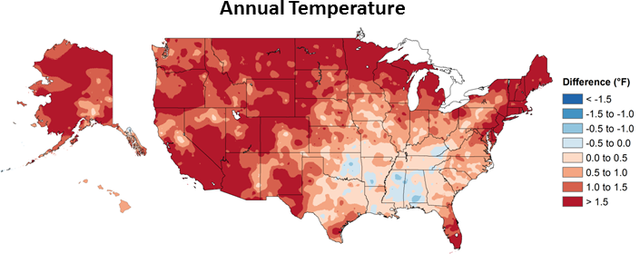
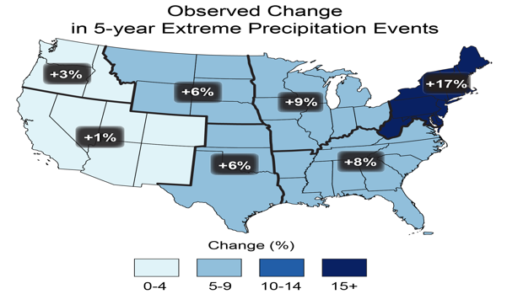
1981-2015 vs 1901-60
Or 1925-1960 Alaska
% diff in top 20% of daily precipitation
National assessment
USGCRP 2017

Slide 28
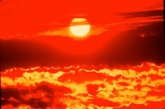
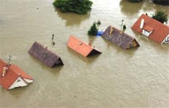
Changes in extremes
Matter most for society and human health
With a warming climate:
  More high temperatures, heat waves
  Wild fires and other consequences
  Fewer cold extremes.
More extremes in hydrological cycle:
  More intense precipitation
  Longer dry spells
  Increased risk of flooding and drought
  More intense storms, hurricanes, tornadoes
Major challenges for a water manager

Slide 29
Recent extremes in Colorado

Slide 30
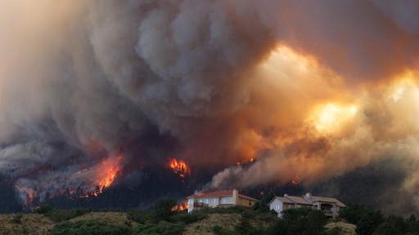
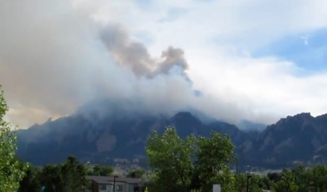
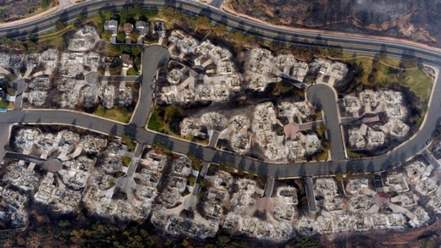
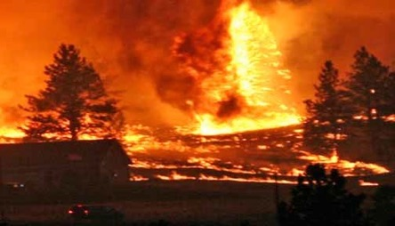
Colorado on Fire: June 2012
Flagstaff fire: above NCAR, circled.
High Park fire 259 houses, 1 death
Waldo Canyon fire
346 homes…

Slide 31
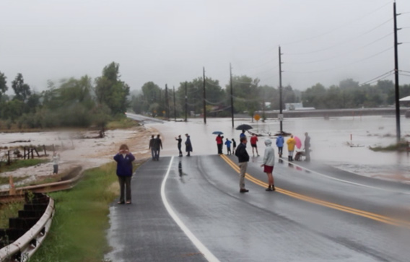
Boulder Flooding September 2013

Slide 32
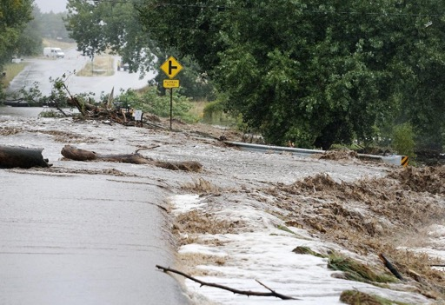
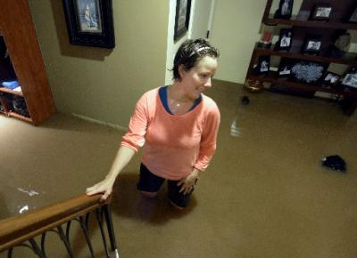
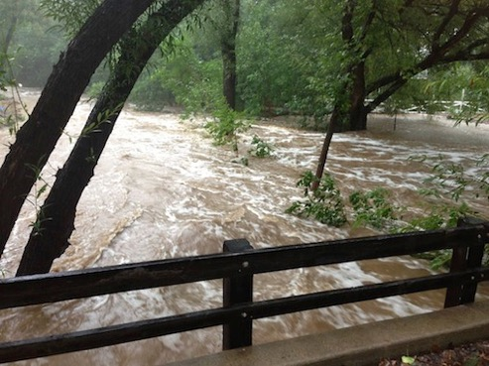
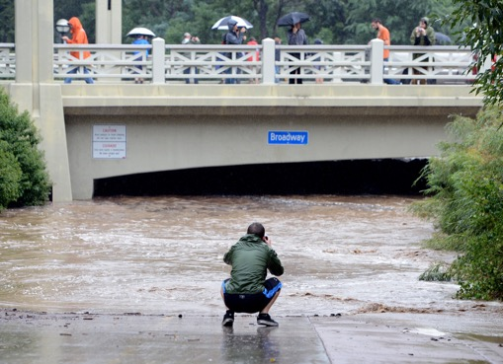

Slide 33
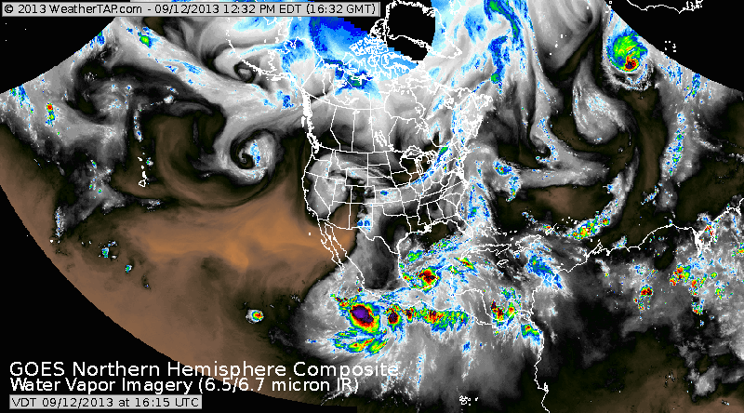
Composite satellite imagery

Slide 34
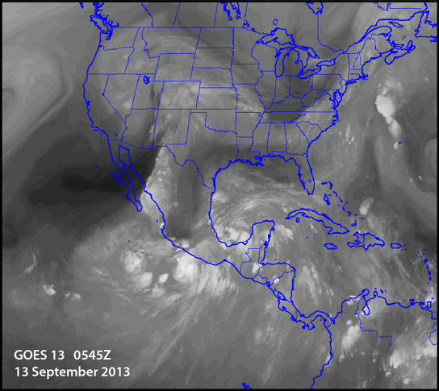
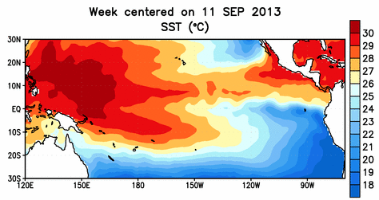
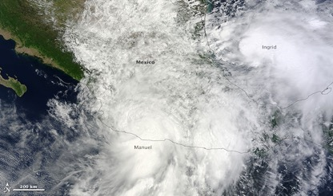
Atmospheric river into CO
Very high above normal SSTs
15 Sept 2013
6.5 micron water vapor channel
NOAA/NESDIS

Slide 35
2017

Slide 36
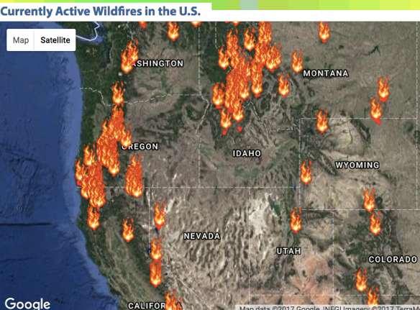
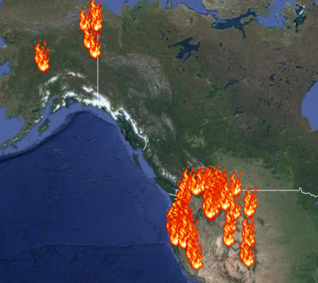
110 wild fires in West
4 Sept 2017
NASA
Canyon fire: Carona CA
Sep 25 2017
Threatens 300 homes
Notes:
https://www.theverge.com/2017/9/12/16295000/extreme-weather-climate-change-wildfires-heat-waves-hurricanes

Slide 37








Devastating wild fires in California: wine country
10-15 Sept 2017
Fires Ravage Northern California’s wine country have left 41 dead, 90 missing and over 6,700 homes and businesses destroyed, making this week's fires among the worst on record in the state in terms of lives and property lost.
(Shades of 1964?)
Notes:
CalFire (2017) Current Fire Information. Accessed October 12, 2017.
San Francisco Chronicle (2017, October 12) The latest on the Wine Country fires. Accessed October 12, 2017.
https://www.theverge.com/2017/9/12/16295000/extreme-weather-climate-change-wildfires-heat-waves-hurricanes
https://s2.washingtonpost.com/28ac3/59e8cc2bfe1ff6159ed35924/dHJlbmJlcnRAdWNhci5lZHU%3D/51/122/da48824b2c9c35334644fae9a9cd7efa
“Flame and Fortune in the American West”, book

Slide 38



Are recent hurricane (Harvey, Irma, Maria) disasters natural?
Yes: hurricanes are natural
No: they were supercharged
These events would not have occurred without human-induced climate change.
And they were further exacerbated by poor preparedness
Harvey: Aug 26 Irma: Sep 7 Maria Sep 19

Slide 39

Hurricanes:
Depend on SSTs > 26ºC (80ºF)
High water vapor content
Weak wind shear (or vortex comes apart)
Weak static stability
Pre-existing disturbance
With climate change:
  More intense hurricanes
  Bigger hurricanes
  Longer-lasting hurricanes
  More flooding rains

Slide 40

Climate change and hurricanes
Hurricanes act as a relief valve for the ocean
They mix and cool the ocean (evaporative cooling)
They moisten the atmosphere
Heavy rains result, releasing latent heat
The heat is redistributed by winds, and
Can then radiate to space
They leave a cold wake behind
Hurricanes thus do not track on same track

Slide 41










Harvey

Slide 42

Harvey
Harvey 24-26 Aug 2017 Developed into cat 4 before Landfall
83 dead
Displaced more than 1,000,000
Damages $150 to $180B (Reuters)
Landfall Aug 25 cat 4
Peak 300,000 homes without power
185,000 homes damaged
1 in 6 had flood insurance
440,000 registered with FEMA for aid as of Sep 1.
64.58” of rainfall at Nederland TX: highest anywhere in US
60.54” at Lake Charles…
Notes:
Moody's Analytics has estimated the total economic cost of the storm at $81 billion to $108 billion or more; most of the economic losses are damage to homes and commercial property.^{[4]} USA Today reported an AccuWeather estimate of $190 billion, released August 31.^{[131]} On September 3, Texas state governor Greg Abbott estimated that damages will be between $150 billion and $180 billion,
Box is 20oN-30oN, 87oW-100oW

Slide 43
Attribution of extremes
While we can not say that these events were due to global warming (poorly posed question),
it is highly likely that they would not have had such extreme impacts without global warming!

Slide 44
Damage from hurricanes
comes from 3 main sources
Wind related damage as the storm comes ashore
Consequences: flying debris, falling trees, power outages
2. Coastal storm surge
  Much worse if landfall occurs at high tide
  Mainly coastal: worse if no wetlands or buffer
  Worsens as sea level rises
3. Heavy rains and flooding
Can extend all the way from Gulf Coast to Canada

Slide 45

How well prepared were people
for Harvey?
Major flooding in Houston area
is not uncommon:
Major flooding event in April 2016
⇒
Yet only 1 in 6 had flood insurance!
In the wake of Hurricane Ike, which claimed 113 lives in Galveston Bay in 2008, proposals for large-scale flood-control projects were rebuffed. Houston’s residents have 3 times voted not to enact a zoning code.
They voted to suffer the consequences!

Slide 46




Irma 7-10 Sept 2017
42+ deaths

Slide 47

Irma 7 Sept 2017
102+ deaths

Slide 48

Puerto Rico: Maria 18-20 Sept 2017

Slide 49

Before and After Maria:
Rio Grande de Manati in Jaguas Ventana, Puerto Rico

Slide 50
Costs of Climate Change
Climate change is happening
It is caused by human activities
For many events we can estimate that the difference from climate change is 5 to 15%.
But this means records are broken
Thresholds are crossed
Things break/flood/burn
    EXTREME NON-LINEARITY
So instead of $1B in damage, the damage is $100B
The real cost of climate change is grossly underestimated by economists.

Slide 51
Climate Change
Climate change is happening
It is caused by human activities
It already costs tens of billions $$$ per year in damages
We can:
Mitigate it: (stop or reduce emissions)
Adapt to it: (plan for the consequences, build resiliency)
Do nothing: suffer the consequences
Stop building in flood plains, stop unbridled growth
Adhere to strict building codes: “Harden” infrastructure
Manage drainage systems and water
Plan evacuation routes
Plan for emergency shelters and power
Utilize flood insurance
Notes:
Total reported economic losses of climate extremes over the 1980–2016 period in the 33 member countries of EIONET (network coordinated from the European Environment Agency – EEA) amounted to about EUR 436 billion at 2016 Euro values.

Slide 52
Contact information
Kevin Trenberth
Distinguished Senior Scientist
Email: trenbert@ucar.edu
http://www.cgd.ucar.edu/staff/trenbert/

